Slide 1
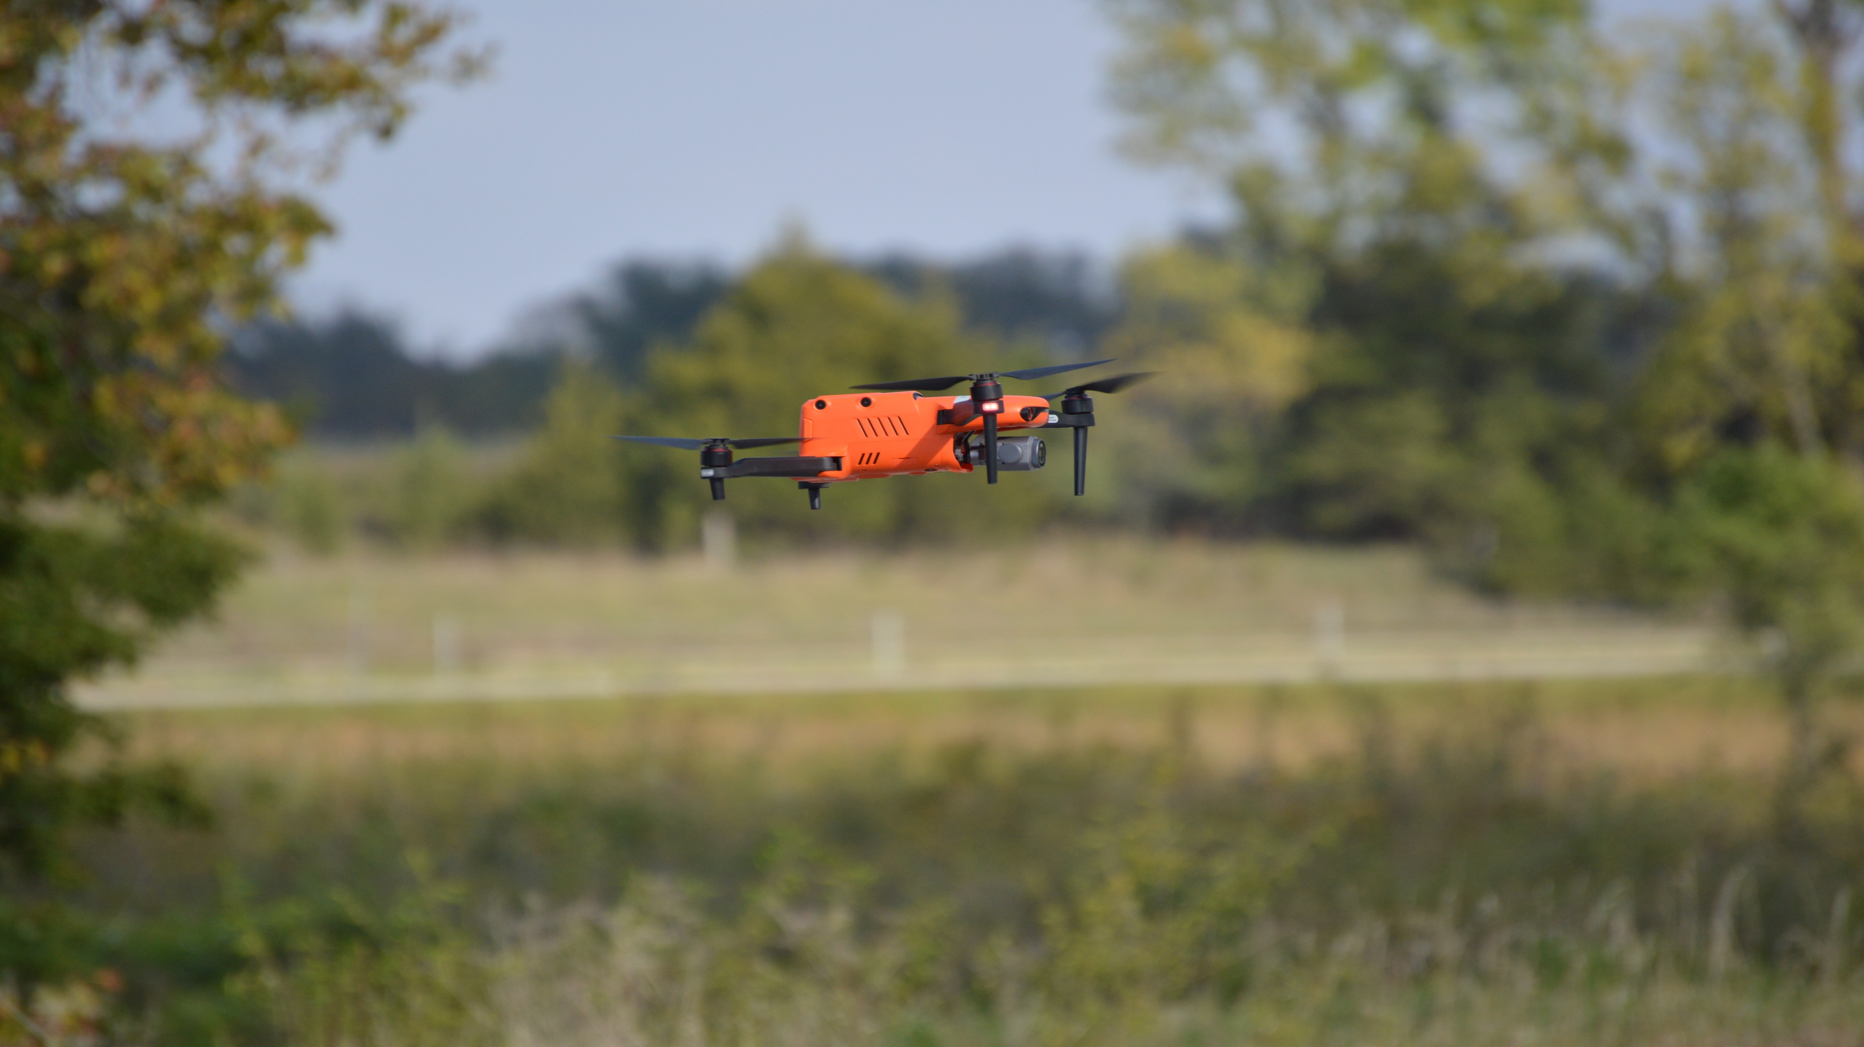
UAS Program
SOUTH DAKOTA DEPARTMENT OF TRANSPORTATION

Slide 2
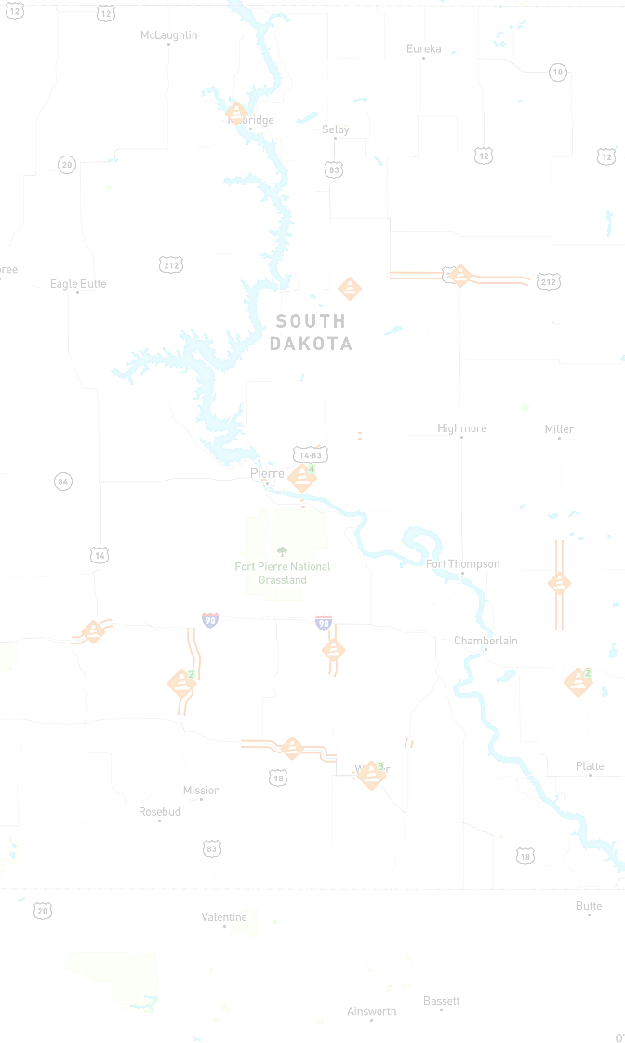
DISCUSSION OUTLINE
Today’s Presentation
By:
Larry Dean
Josh Olson
Jon Nelson
A Brief Background/Overview
Bridge Inspection Overview
Survey Overview

Slide 3
UAS IMPLEMENTATION TIMELINE
2019
FHWA EDC 5 Initiative.
Innovation Committee Organized.
Buy in from Executive Team.
UAS Group Organized.
2019 Cont.
FHWA Peer Exchange Grand Forks ND.
Iowa, Minnesota, Montana, Wyoming, South Dakota
2019-2020
Development of UAS Procedures and Guidelines Documents.
Aid of Iowa and Utah DOT’s Documents.
UAS Internal and External Stakeholders Group Comment and Review.
2020 Cont.
UAS Procedures and Guidelines Approved.
SDDOT UAS Committee was Organized.
Use UAS’s as a Tool for Bridge Inspections and Survey.

Slide 4
UAS PROCEDURES

Slide 5
UAS GUIDELINES

Slide 6
Mike Behm
(Division Director)
Larry Dean
(Planning Data Manager)
Jack Dokken
(Air, Rail, Transit Administrator)
Cody Axlund
(LGA Lead Bridge Engineer)
Josh Olson
(Senior Region Bridge Supervisor)
Josh Bench-Bresher
(Asset Management Engineer)
Cody Asher
(Survey Crew Chief)
Hayden Malsam
(Transfer & Asset Specialist)
Marc Hoelscher
(FHWA)
Jon Nelson
(Road Design Land Surveyor)
UAS Committee Members

Slide 7
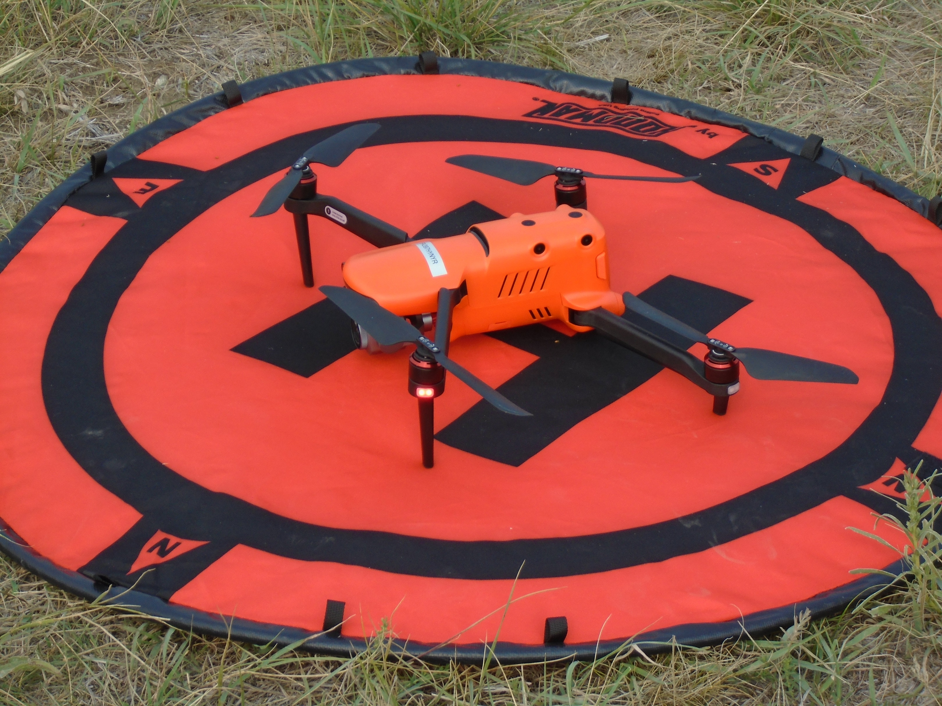
UAS Aircraft
Autel Evo II Pro
GPS Enabled
20 Megapixels Camera Sensor
40 Minute Battery Life
1 Aircraft Purchased in 2021
Slide Body Content

Slide 8
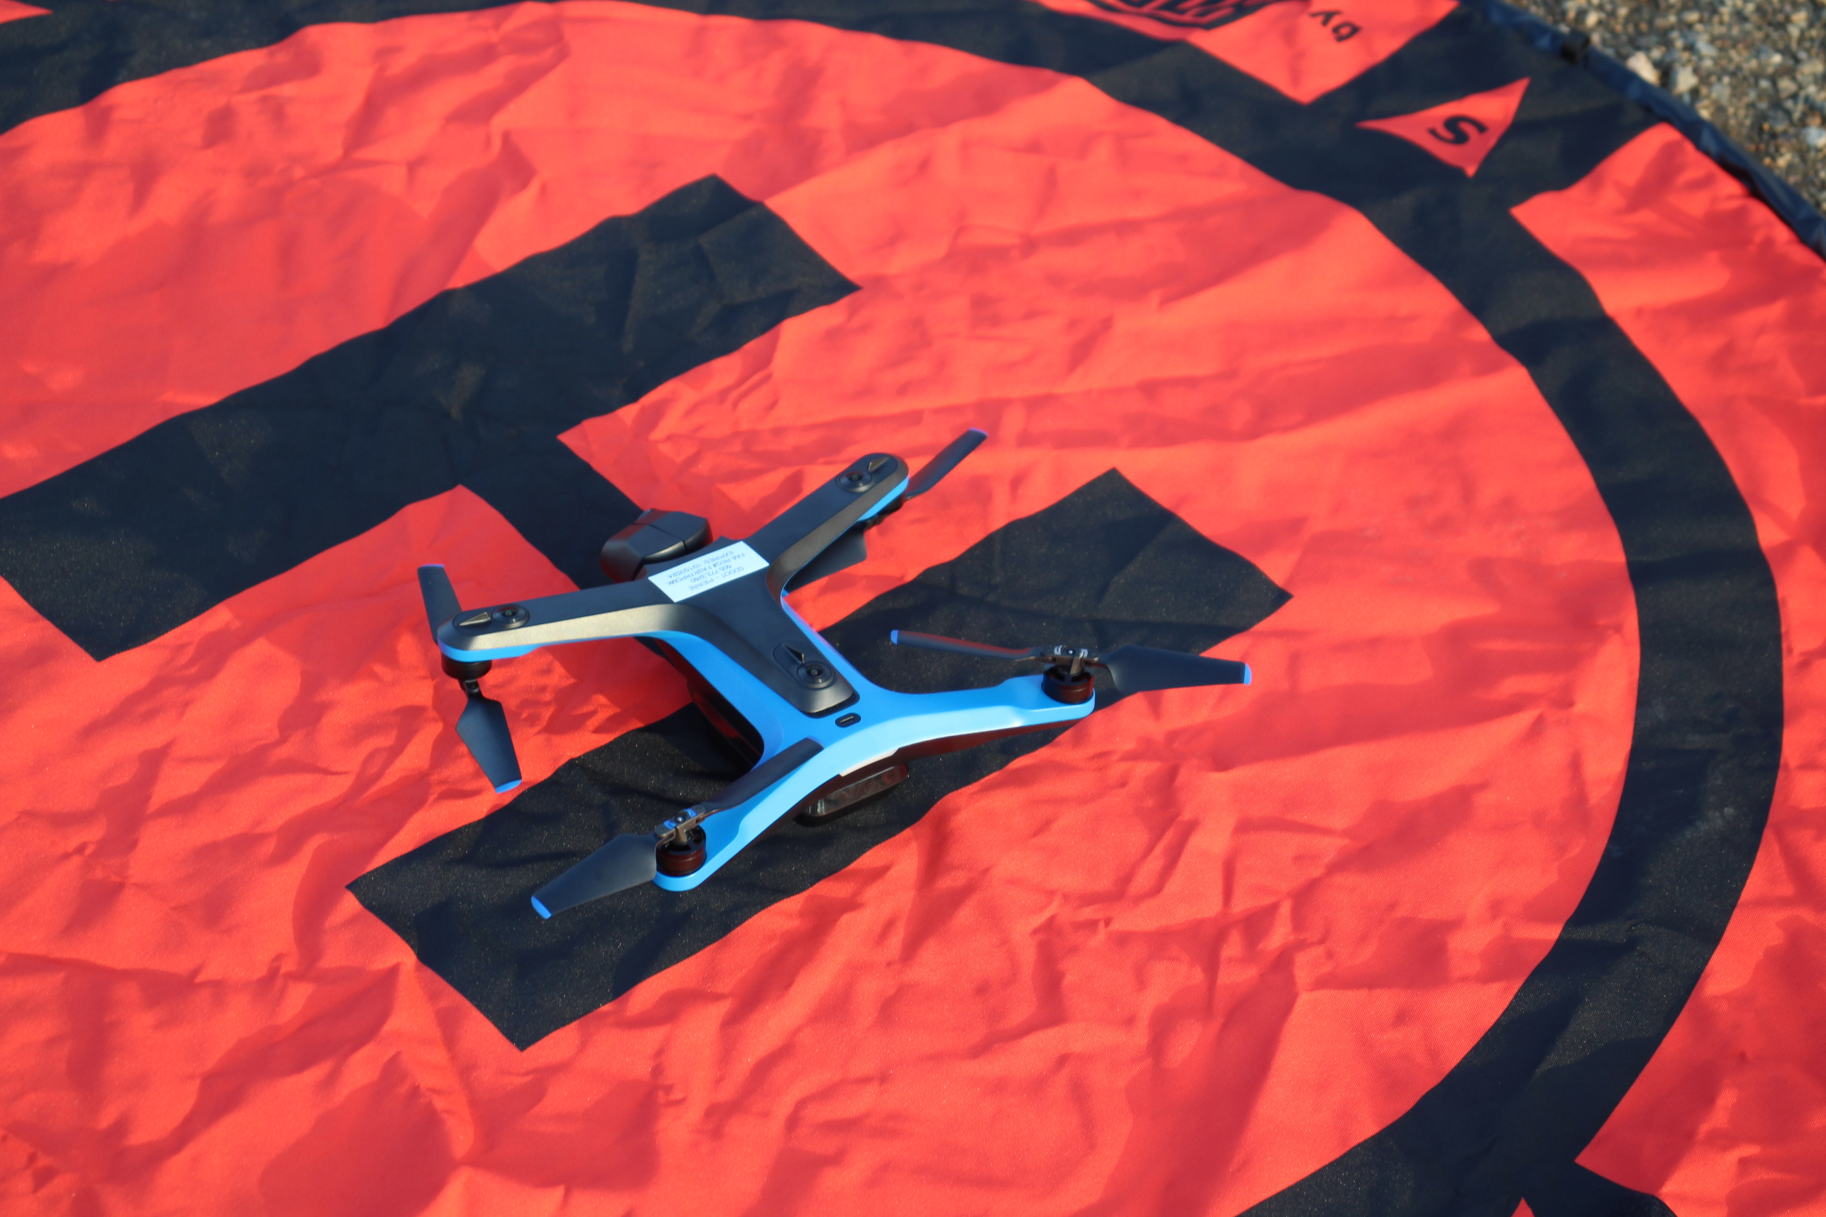
UAS Aircraft
Skydio II Pro
GPS/Non-GPS Enabled
12.3 Megapixels Camera Sensor
23 Minute Battery Life
Autel Evo II Pro
Only GPS Enabled
48 Megapixels Camera Sensor
4 Aircraft Purchased in 2021 With the Autonomy Enterprise Foundation (AEF) Software
Slide Body Content
40 Minute Battery Life
1 Aircraft Purchased in 2021

Slide 9
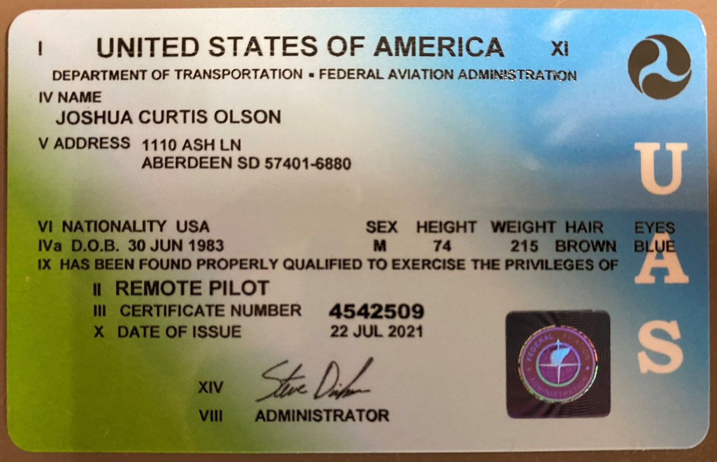
Part 107 Remote Pilot License
10 Pilots were trained by Frontier Precision to prepare for the Part 107 FAA examination.
10 Pilots passed the Part 107 examination. Need to retest every 2 years.
Each performed 2 hours of flight time on the aircraft they are assigned.
After the 2 hours of flight each pilot went through a knowledge test and a field flight review with a trained flight examiner from the SDDOT. Need to re-test every 2 years or when a new type of aircraft is purchased.

Slide 10
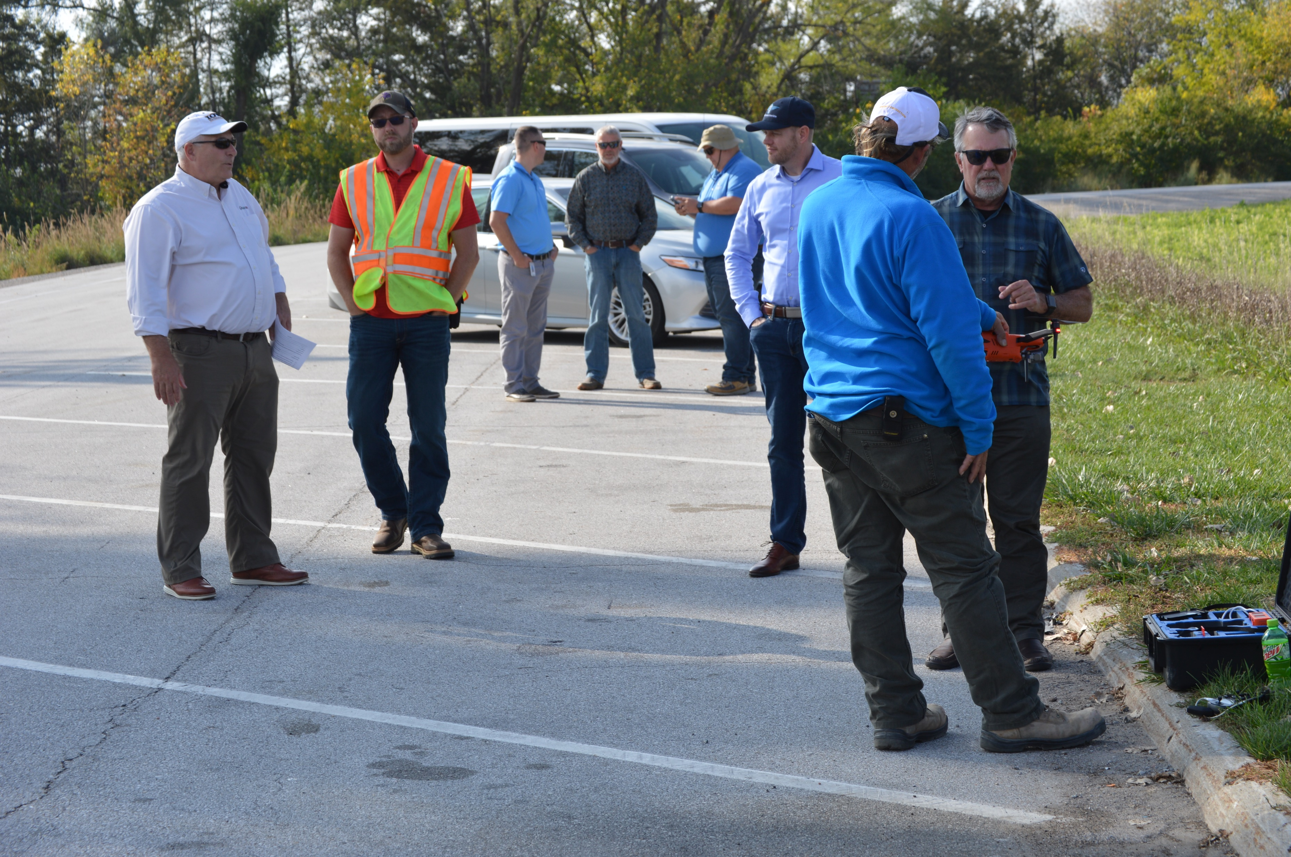
FHWA PEER EXCHANGE WITH IOWA DOT, Ames Iowa
Slide Body Content
SDDOT Participated in a FHWA Peer to Peer Exchange with Iowa DOT on October 6, 2021.
Iowa DOT discussed an overview of their UAS program, the organization structure, pilot requirements, UAS platforms, funding sources and budget, data storage, privacy concerns and their flight review process.

Slide 11
FLIGHT REVIEW
Slide Body Content
LAANC
FAA’s Low Altitude Authorization and Notification Capability
Pilots can obtain airspace authorizations to fly in controlled airspace.
Mobile Applications:
B4UFLY
Aloft
AirMap

Slide 12
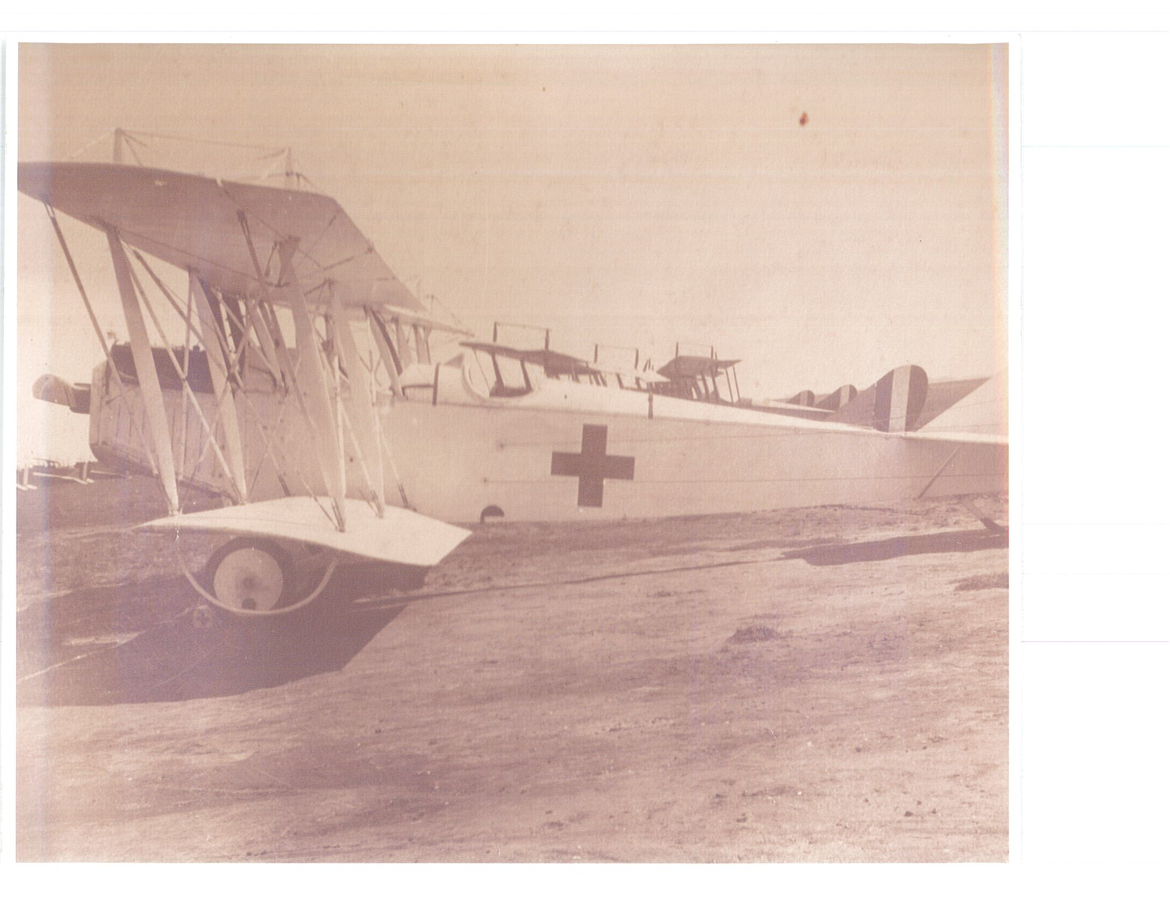
Airspace
Slide Body Content
LAANC
FAA’s Low Altitude Authorization and Notification Capability
Pilots can obtain airspace authorizations to fly in controlled airspace.
Mobile Applications:
B4UFLY
Aloft
AirMap

Slide 13
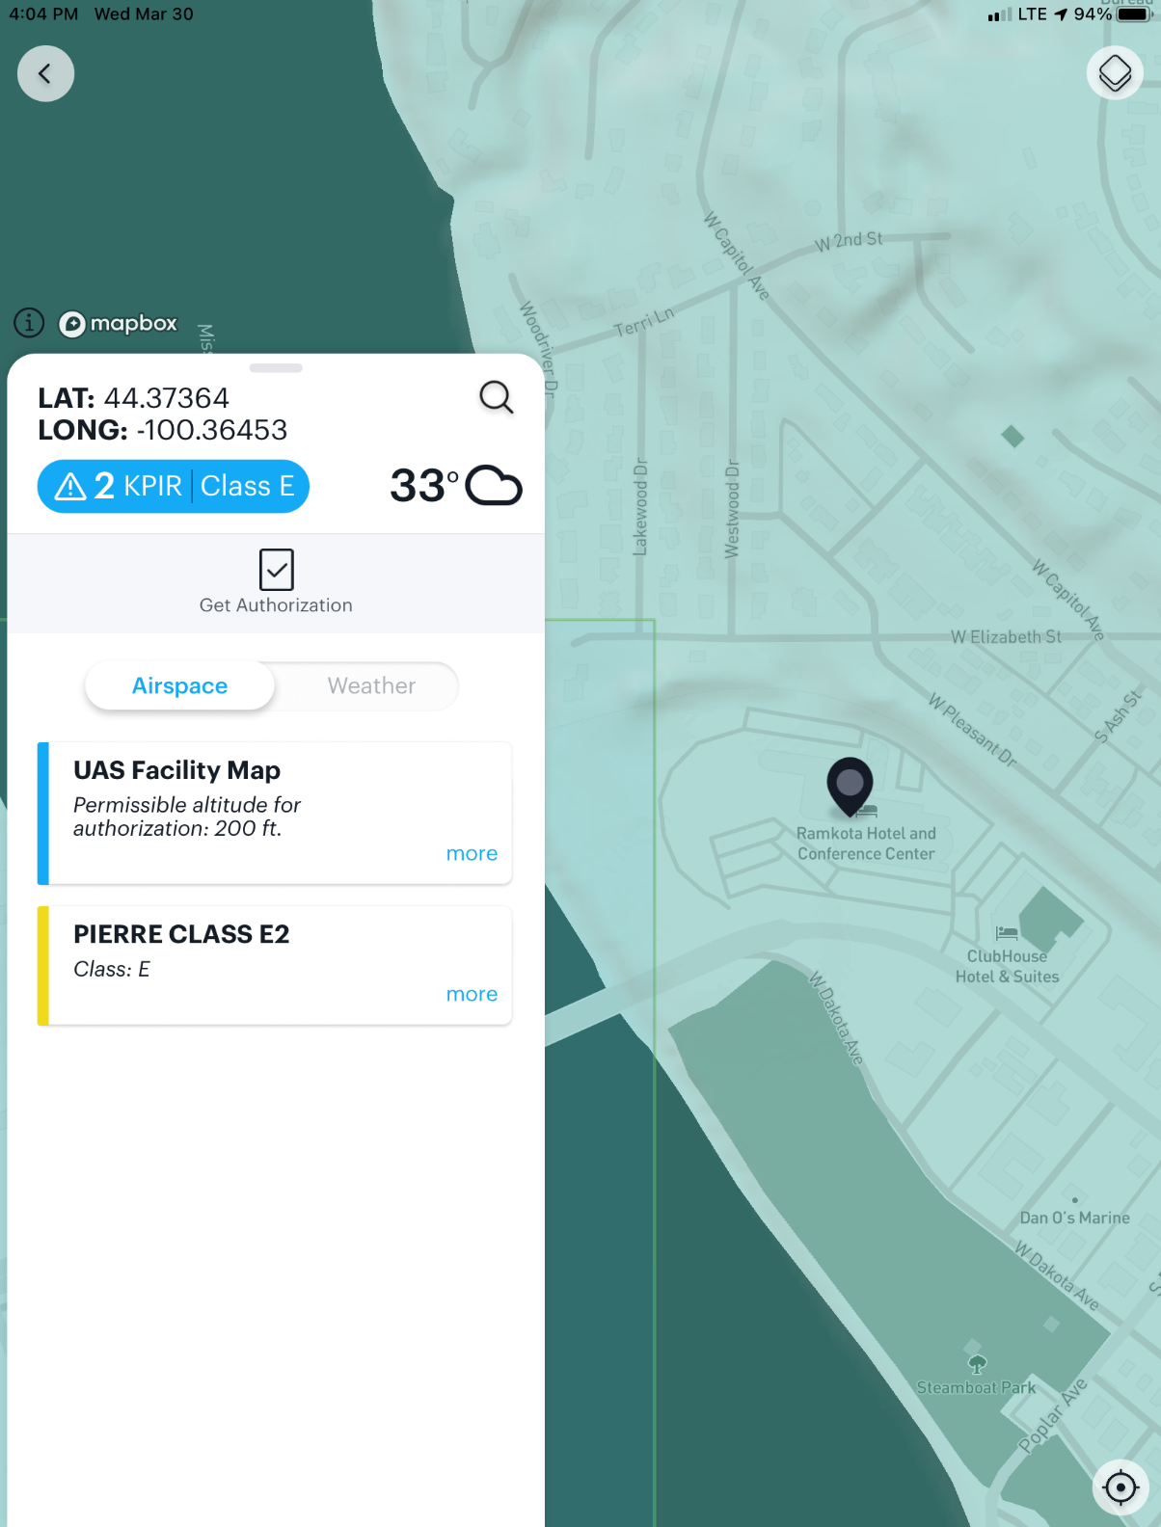
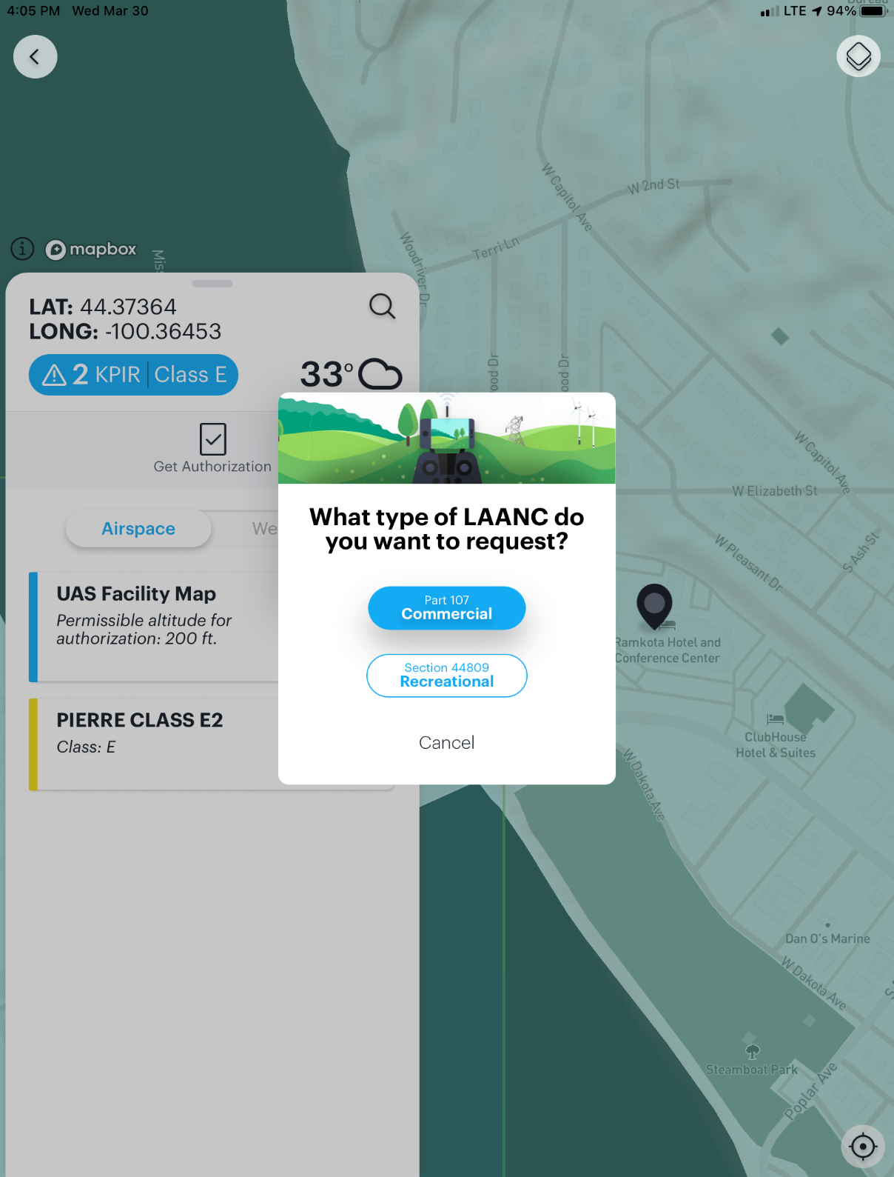
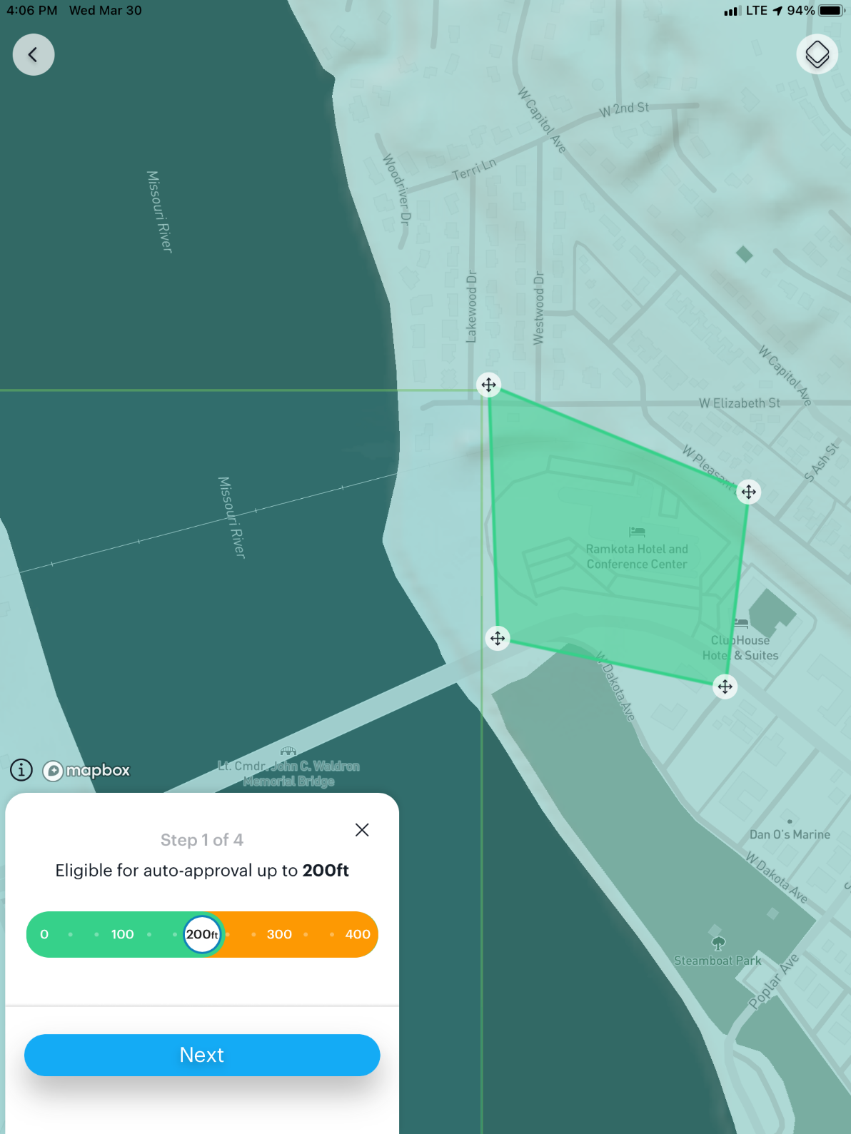
Steps
LAANC Steps – Aloft

Slide 14
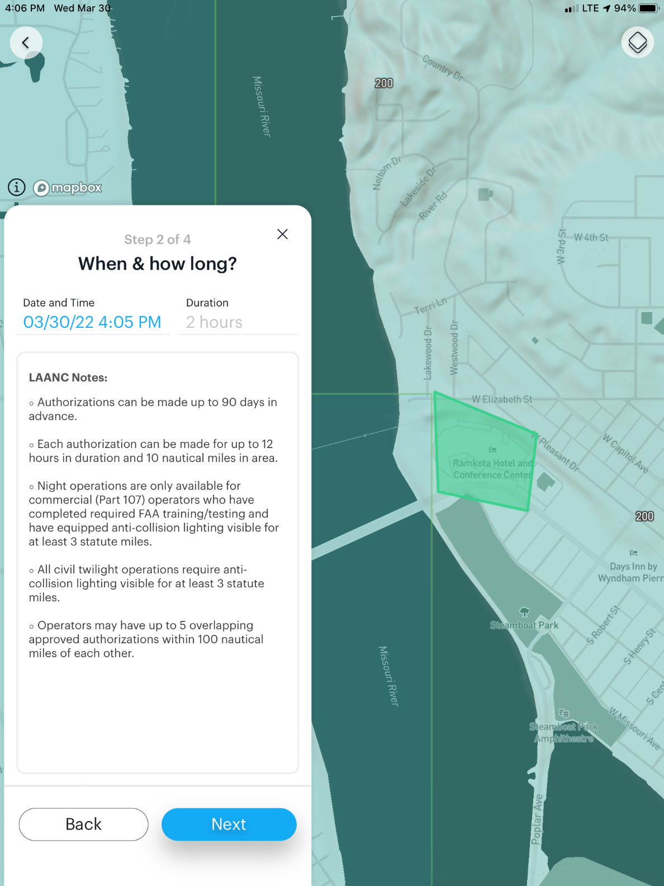
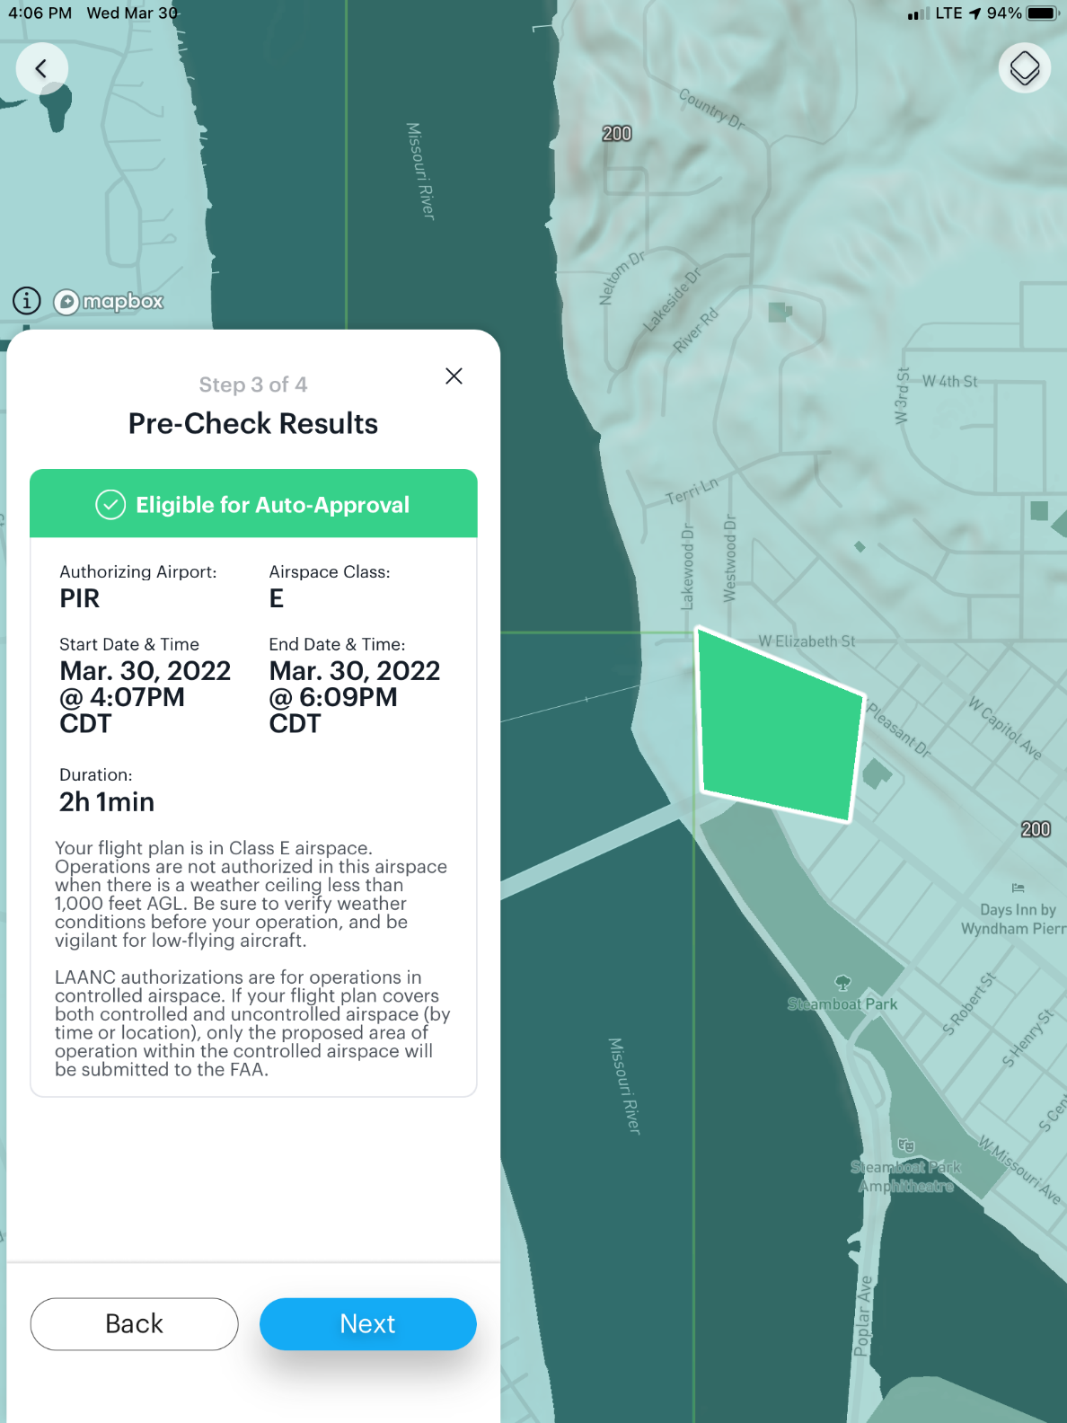
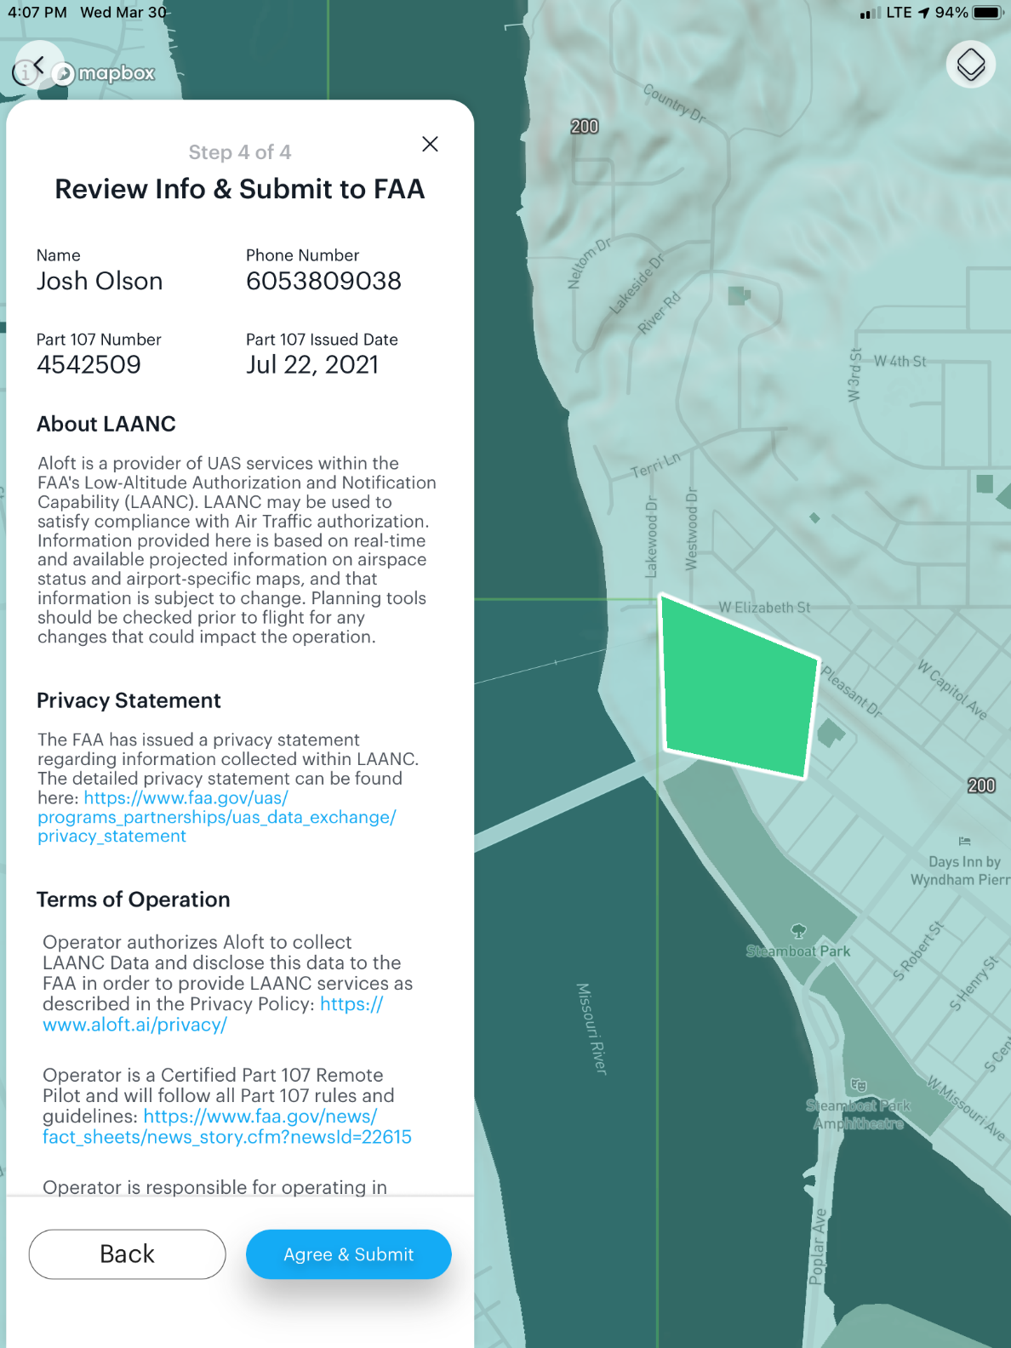
Steps - Continued
LAANC Steps – Aloft

Slide 15
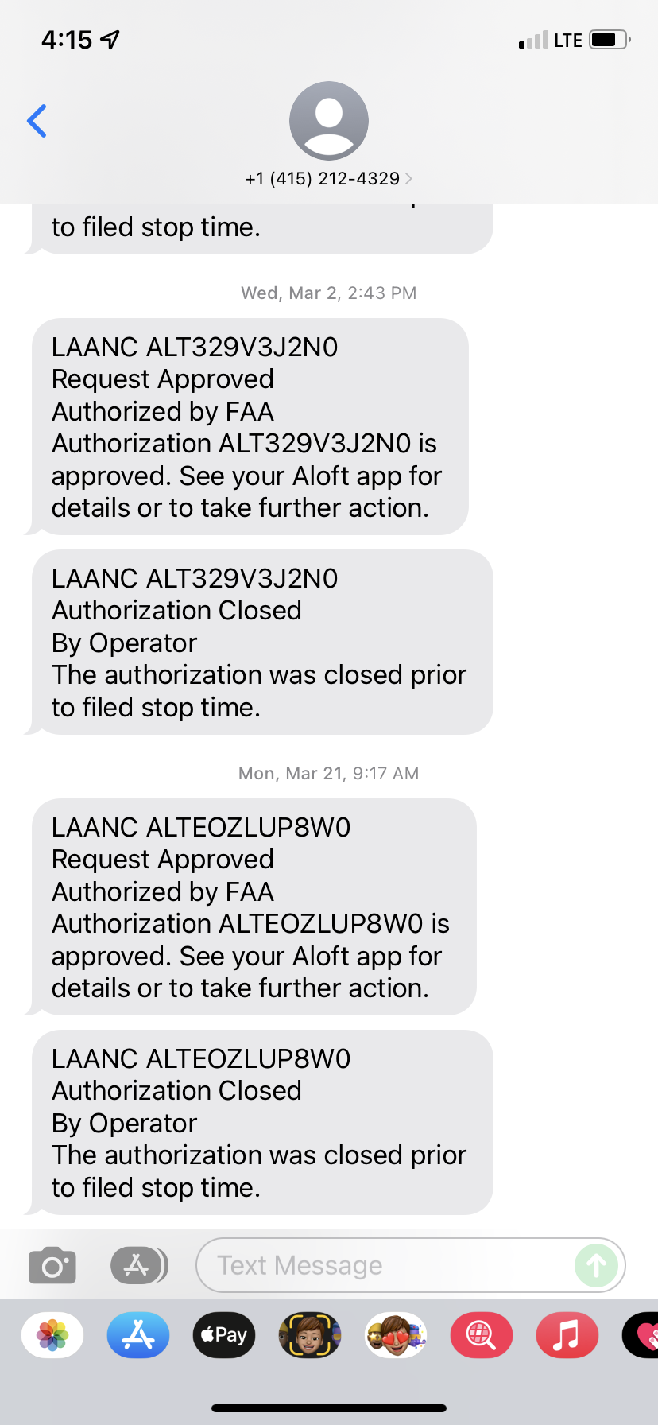
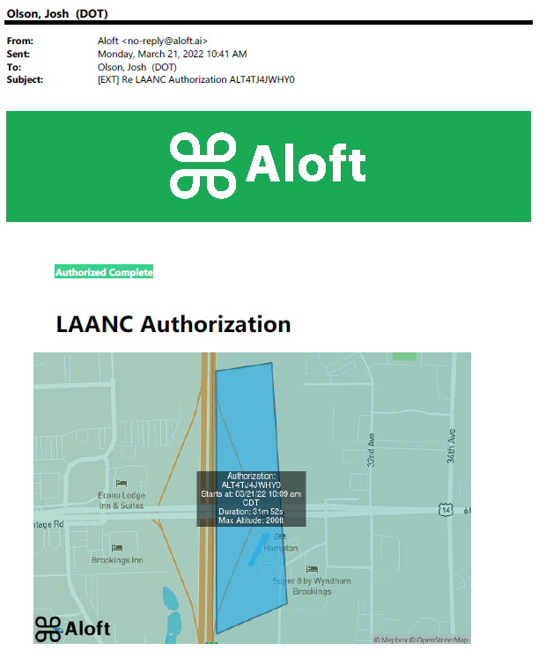
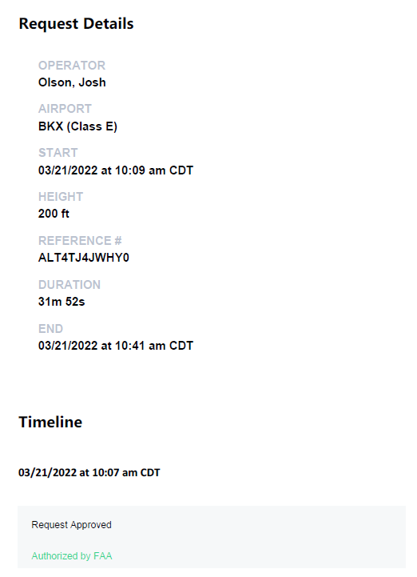
LAANC Confirmation – Aloft

Slide 16
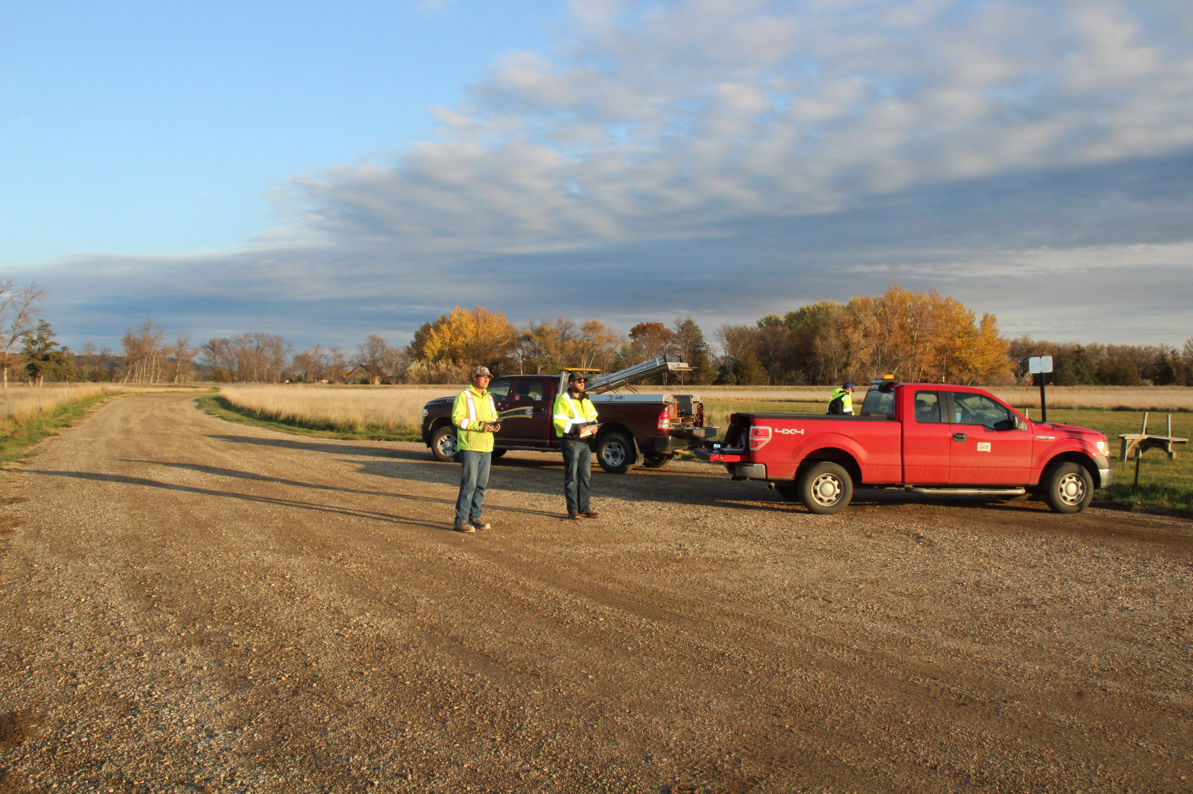
PREFLIGHT PLANNING
UAS Pre-flight Checklist
Remote Pilot Certificate (current)
UAS Registered (current)
Updated Firmware/Apps
Batteries Charged
Weather Conditions
NOTAMs/TFRs
Airspace Authorization
Site Plan/Flight Plan
Part 107 Compliance
Inspect Aircraft/Control Links
Slide Body Content
LAANC
FAA’s Low Altitude Authorization and Notification Capability
Pilots can obtain airspace authorizations to fly in controlled airspace.
Mobile Applications:
B4UFLY
Aloft
AirMap

Slide 17
INSURANCE
Slide Body Content
LAANC
FAA’s Low Altitude Authorization and Notification Capability
Pilots can obtain airspace authorizations to fly in controlled airspace.
Mobile Applications:
B4UFLY
Aloft
AirMap
SDDOT has a blanket insurance policy for the UAS’s that is associated with the manned aircraft policy.
Each pilot and aircraft is insured.

Slide 18
UAS IS A TOOL
UAS IS JUST ANOTHER TOOL IN THE TOOLBOX LIKE A HAMMER BUT WITH REGULATIONS AND TRAINING.
Slide Body Content
LAANC
FAA’s Low Altitude Authorization and Notification Capability
Pilots can obtain airspace authorizations to fly in controlled airspace.
Mobile Applications:
B4UFLY
Aloft
AirMap

Slide 19
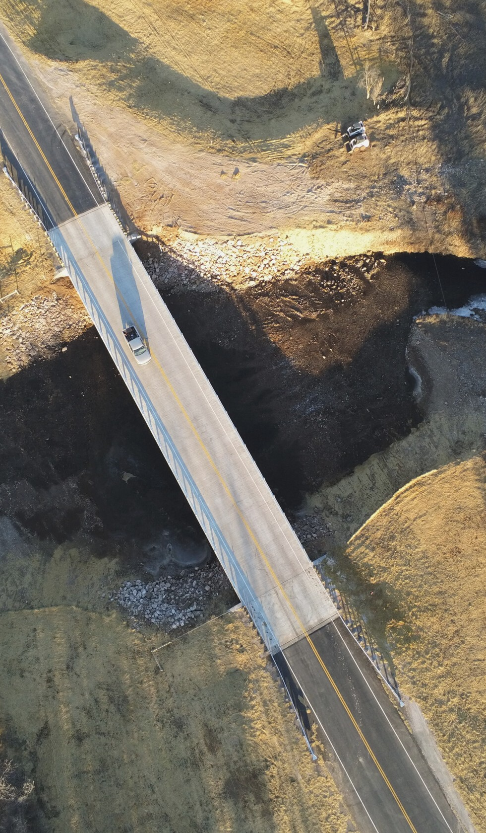
Bridge Inspection Overview
Bridge inspections are required to be performed every 2 to 4 years for all bridges open to the travelling public.
23 CFR, Chapter I, Subpart G, Part 650
Very time consuming and labor intensive with lane closures and heavy equipment.

Slide 20
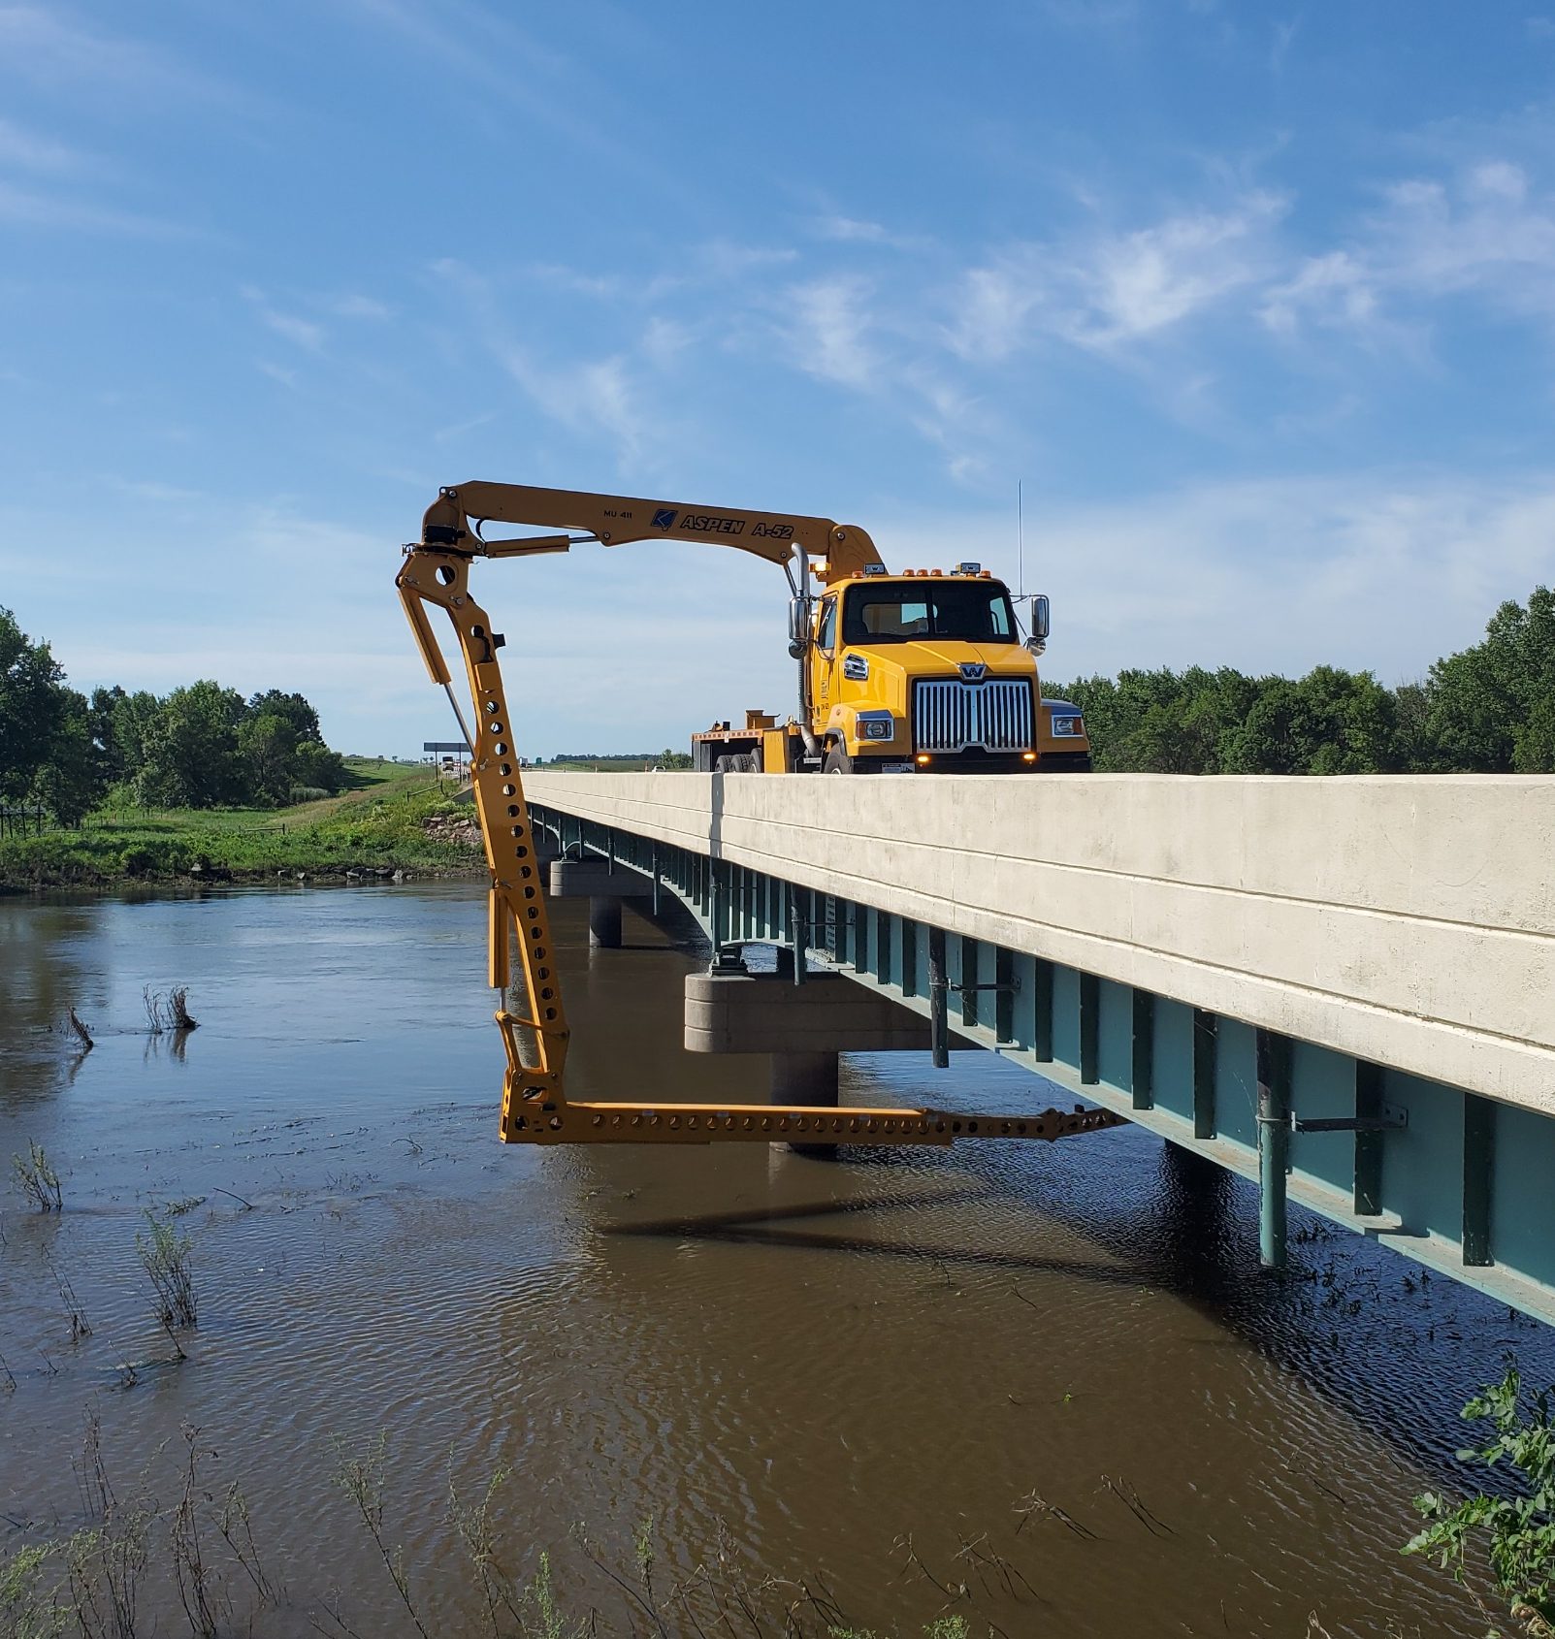
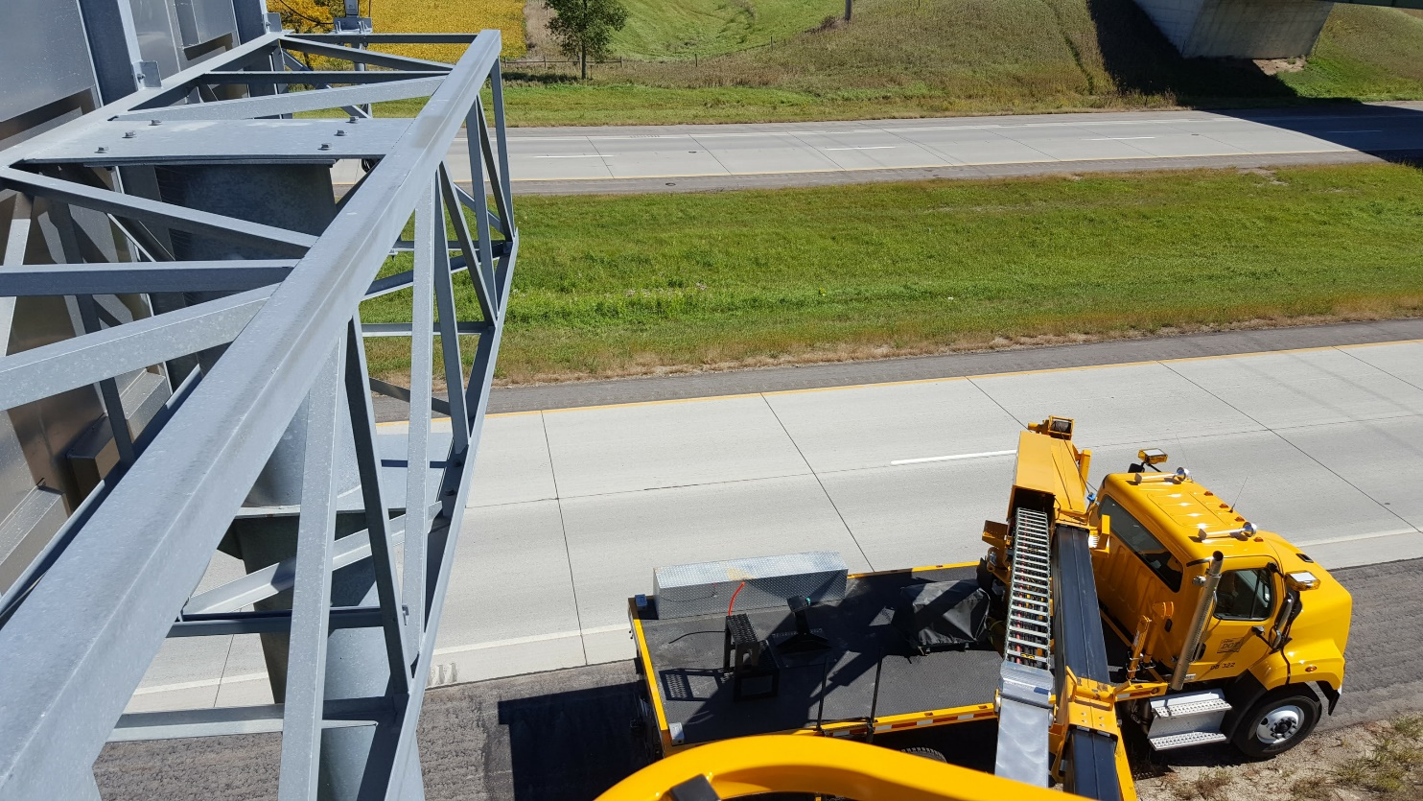
BRIDGE INSPECTION
Current Practice

Slide 21
GOALS FOR
BRIDGE UAS
Ability to Fly Under the Bridge & Look at the Underside
Typically operate in GPS denied environments.
High MP Camera/4K
Higher quality photos mean less distortion when zooming in on a picture. Also, if modelling becomes an option, may get away with less pictures.
Long Battery Life
Looking for longer flights and less battery changes.

Slide 22
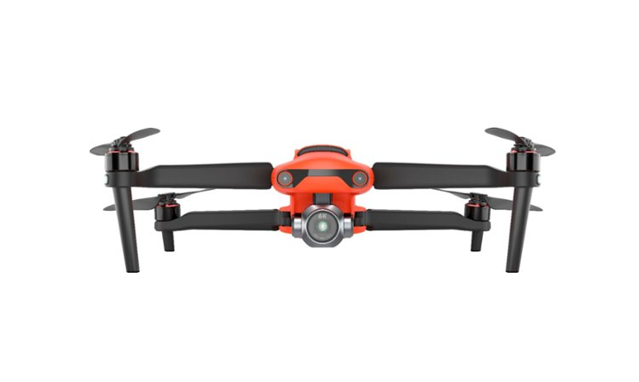
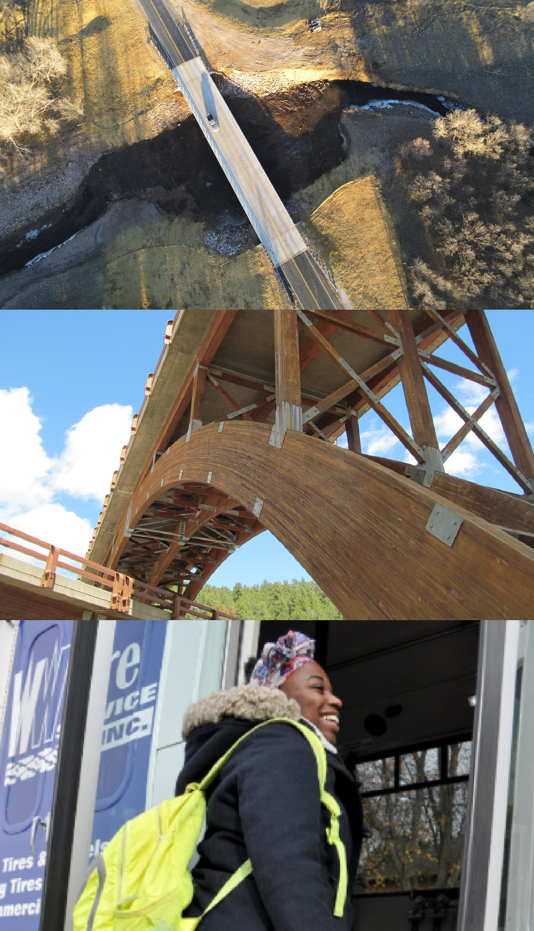
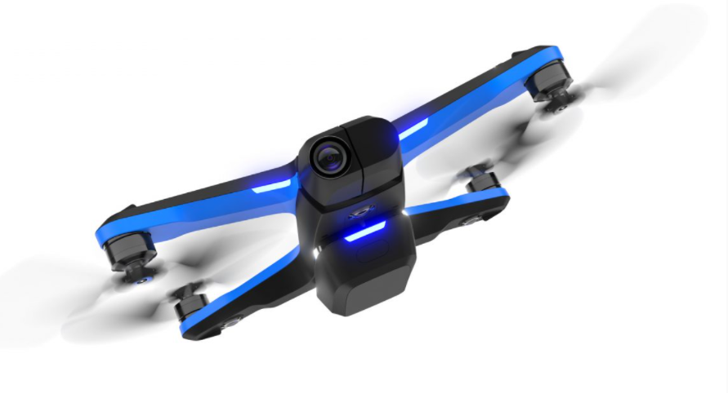
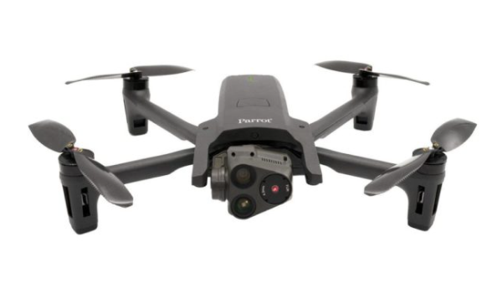
Autel Evo 2 Pro
Lacked GPS denied environment capability.
Camera is only able to look +30° to -90°.
Cost was a plus.
Battery life was a plus.
The UAS Contenders
Skydio S2
Able to fly in GPS denied environments.
Camera is able to look +90° to -90°.
Cost was a plus.
Battery life was a little low.
Parrot Anafi USA
Unable to fly in GPS denied environments.
Camera is able to look +90° to -90°.
Cost was high.
Battery life was a plus.

Slide 23
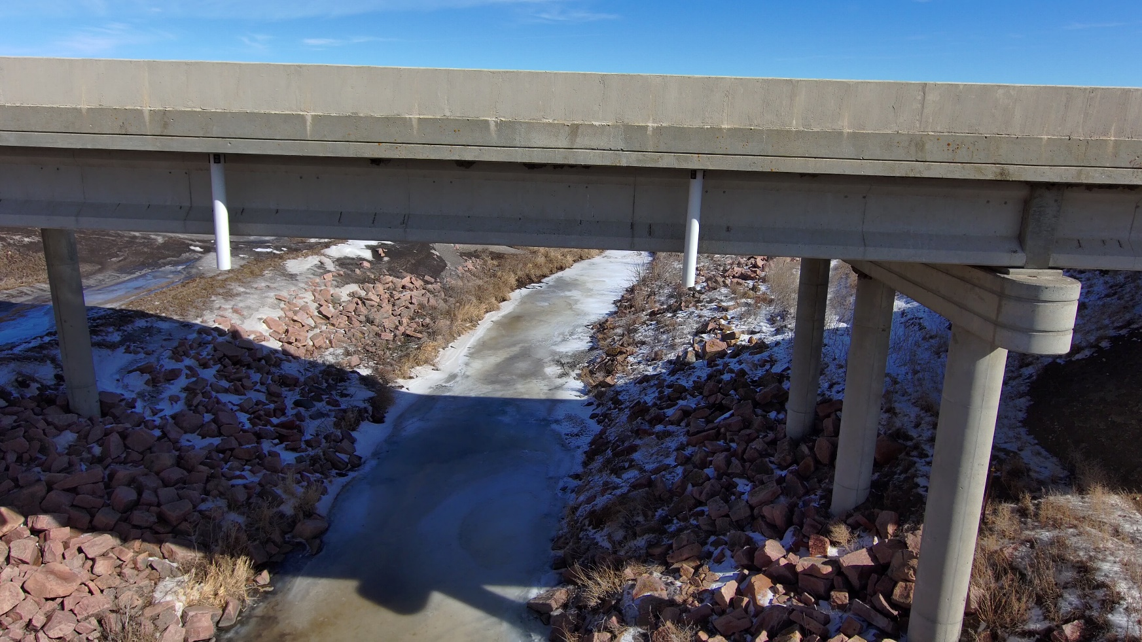
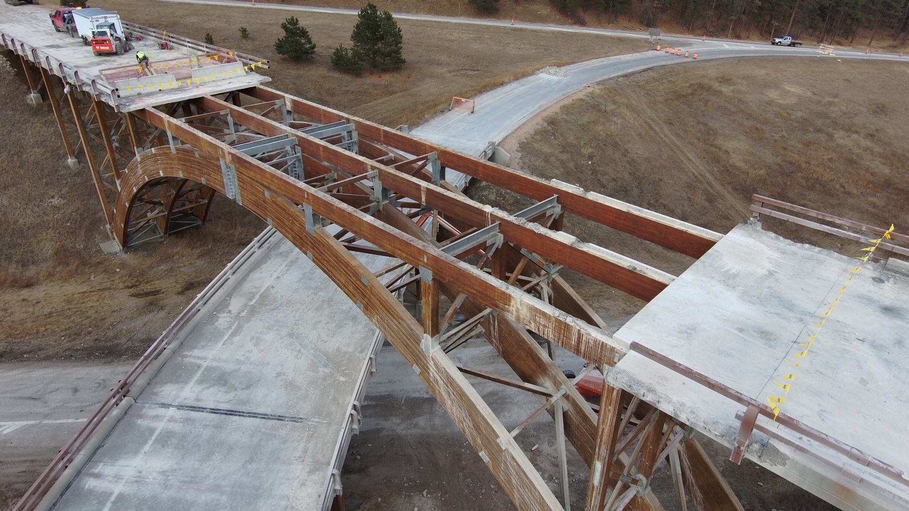
How We are Using Them.

Slide 24
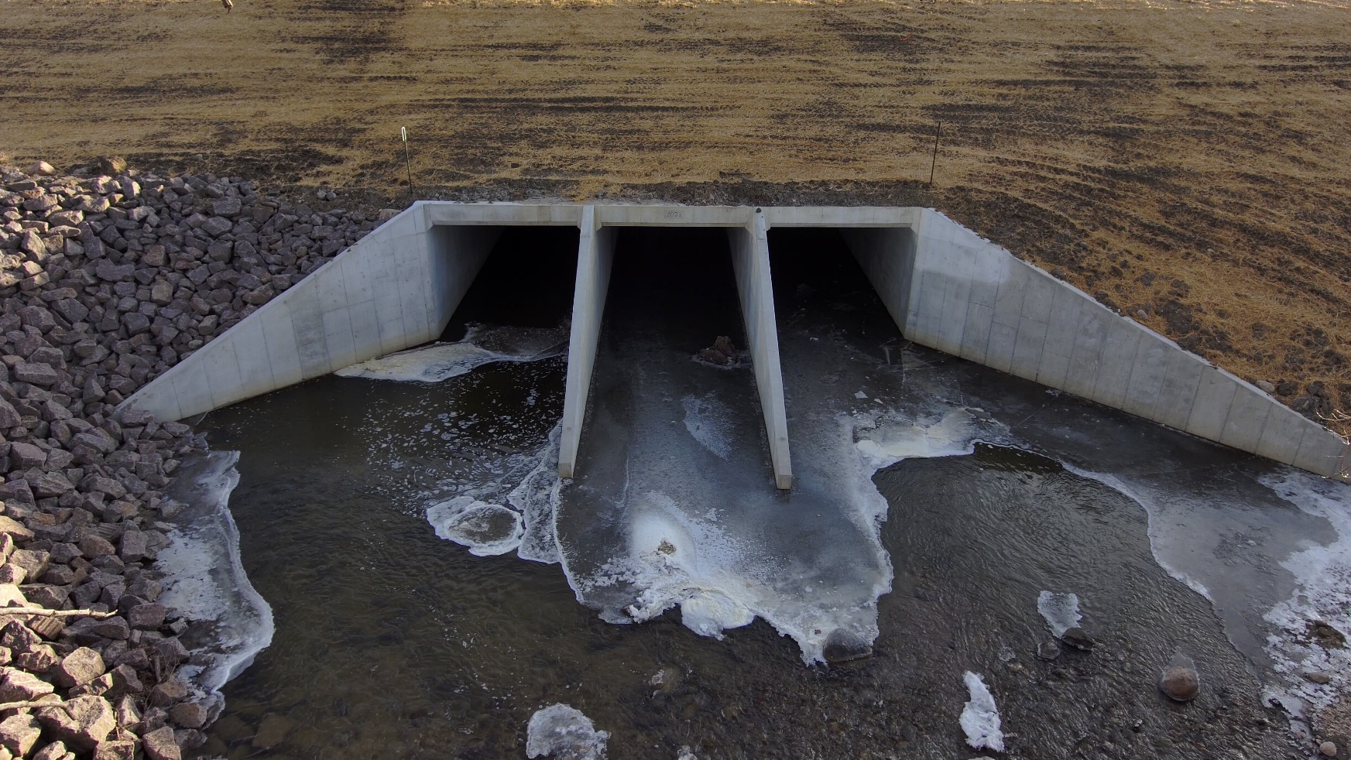
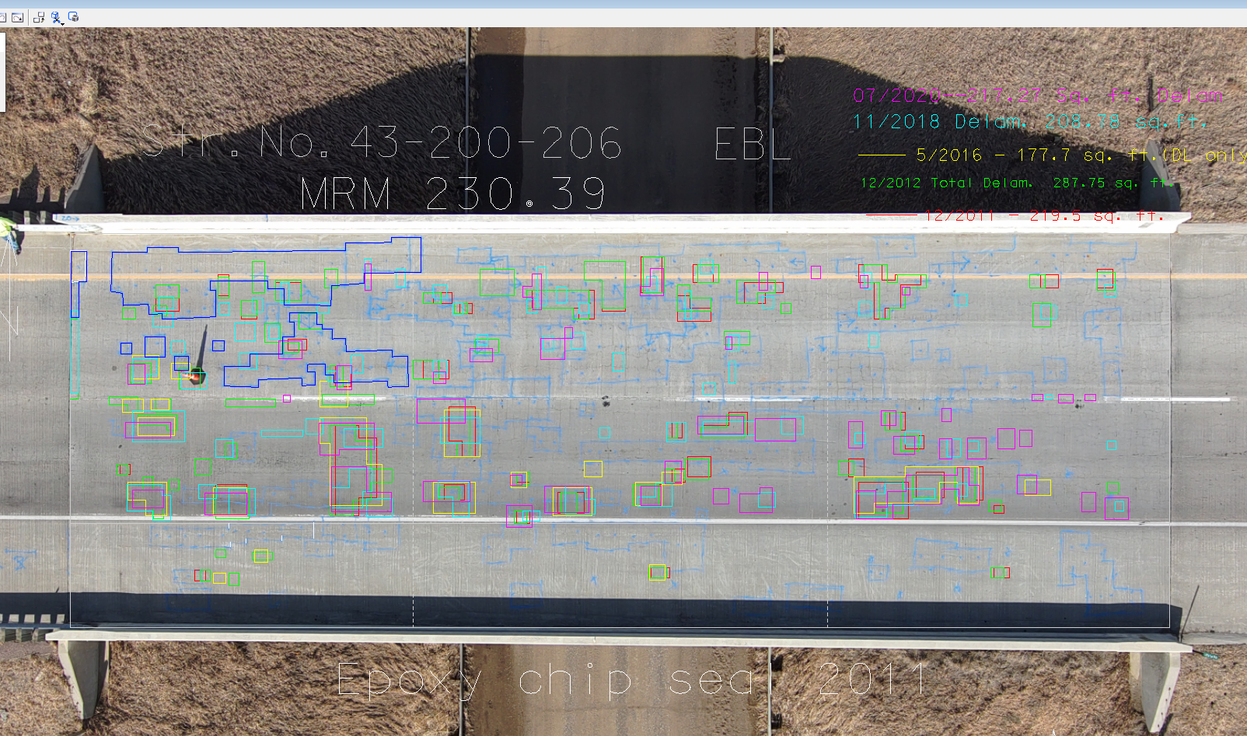
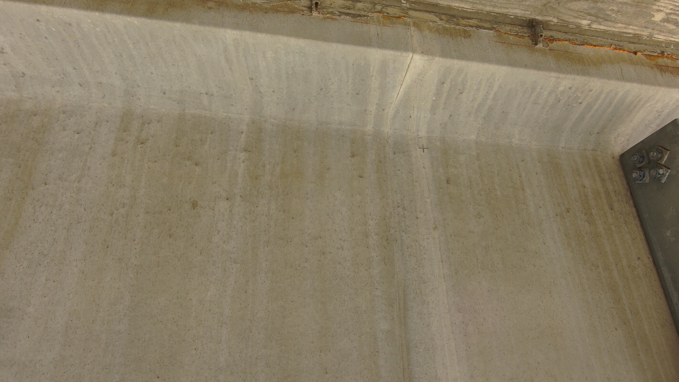
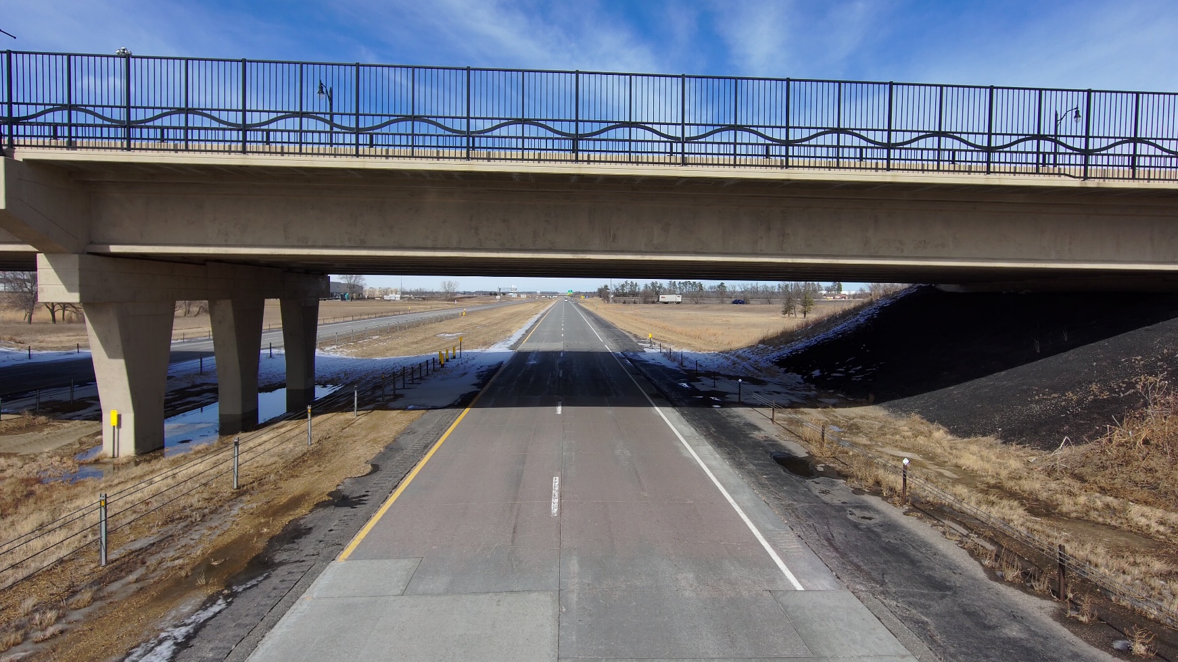
How We are Using Them.

Slide 25
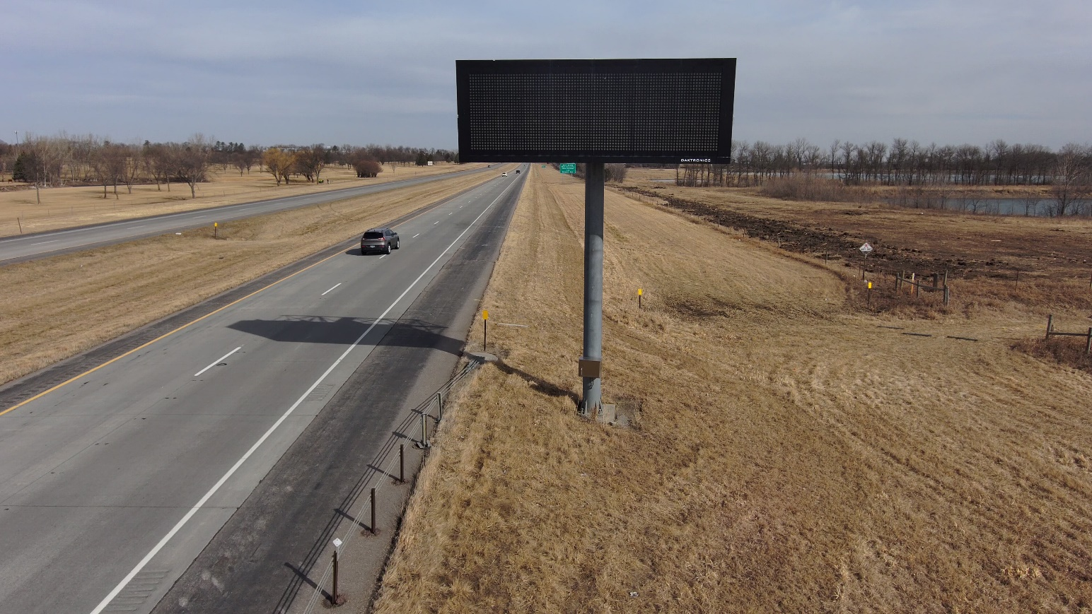
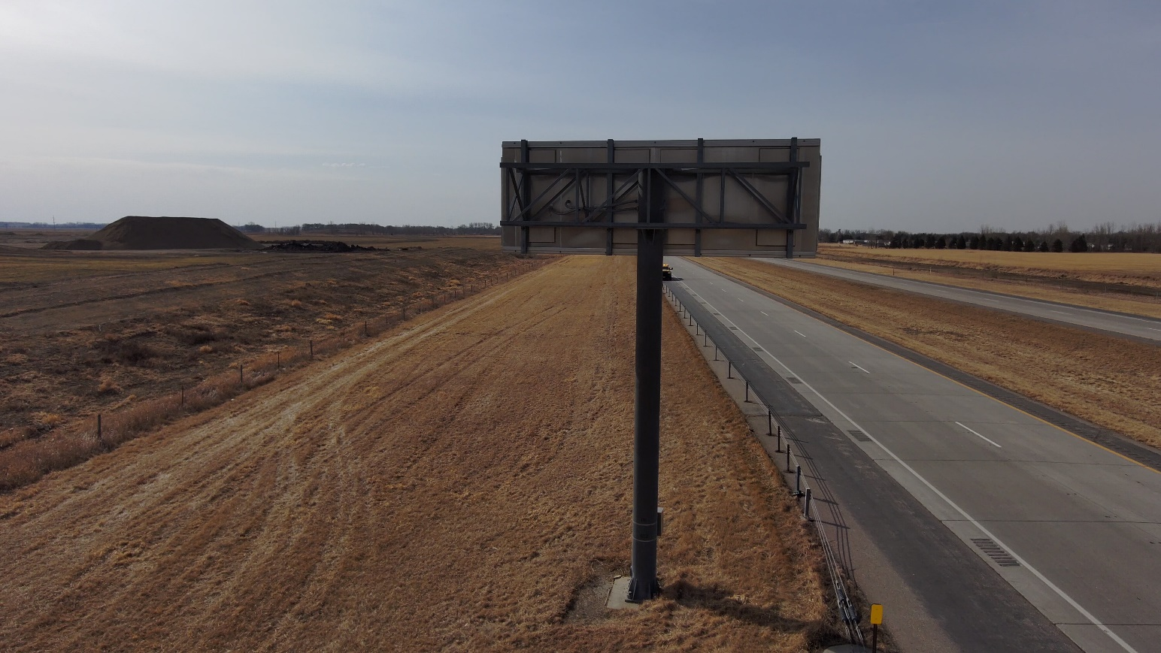
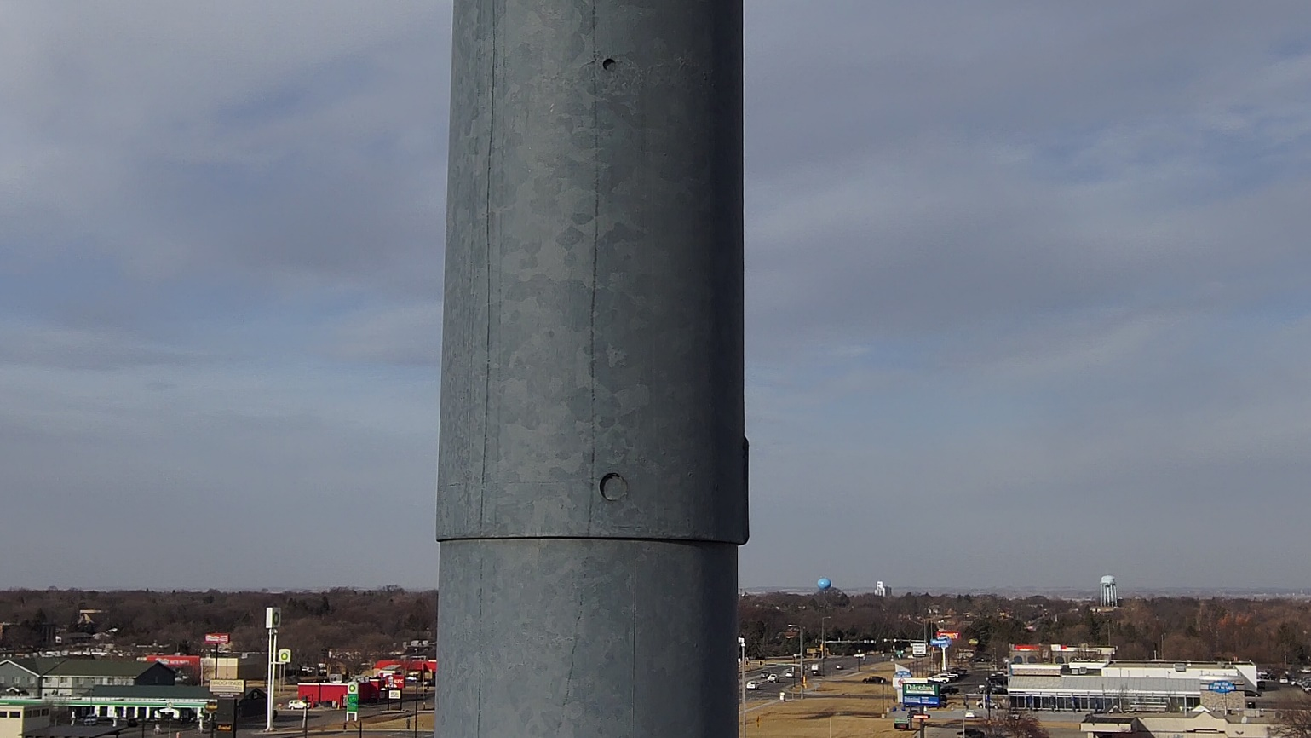
How We are Using Them.

Slide 26
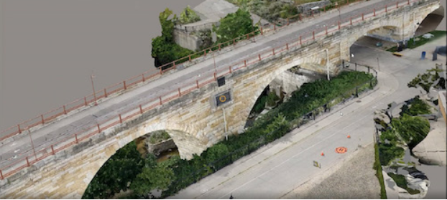
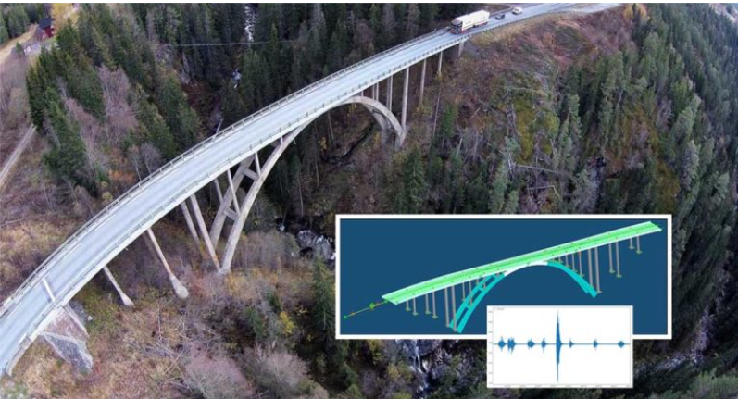
Where are We Going?

Slide 27
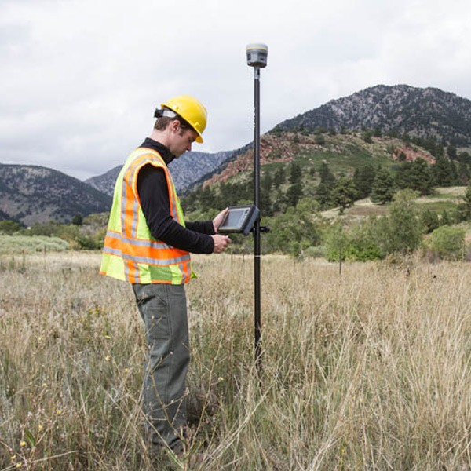
Survey Overview
Topographic Surveys are required for all transportation projects within SDDOT.
Highway corridor surveys are time consuming requiring lane closures and or traffic control.
Concerns with employee safety due to higher traffic volumes, especially in and around urban centers.
Increased workload with decreasing number of employees.
Notes:
Legislature has put a cap on the number of FTE we can hire at SDDOT so we are leveraging technology to our advantage to close that gap

Slide 28
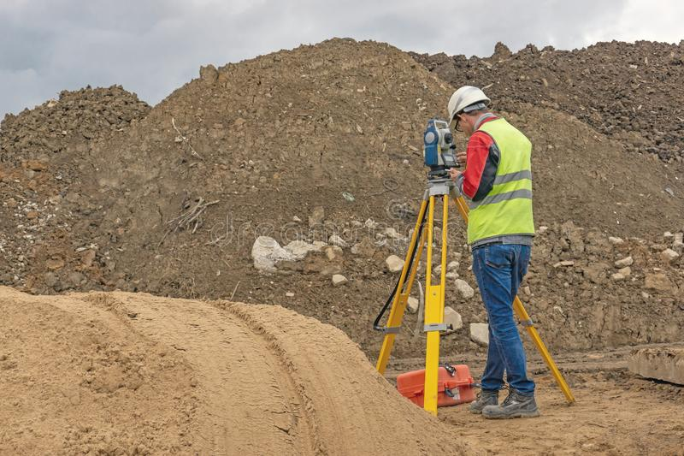
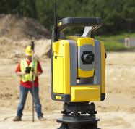
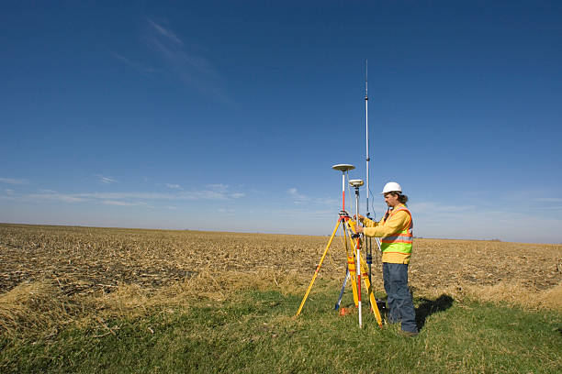
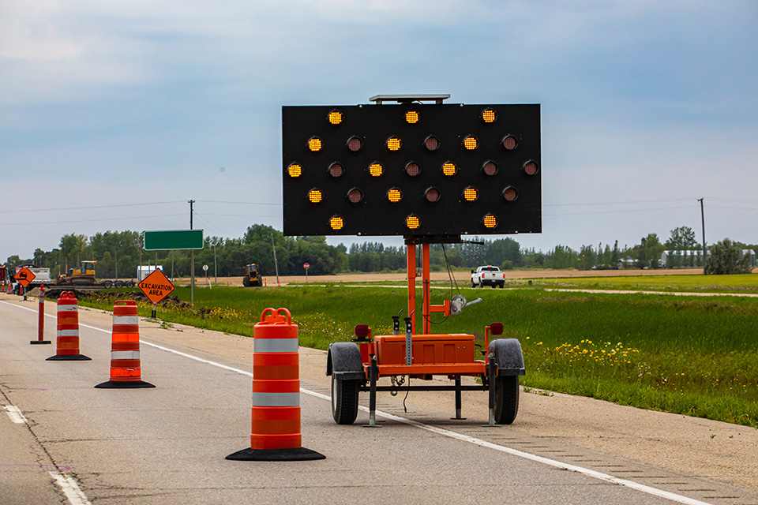
Current Practice
TOPOGRAPHIC SURVEYS
Notes:
Ground surveys

Slide 29
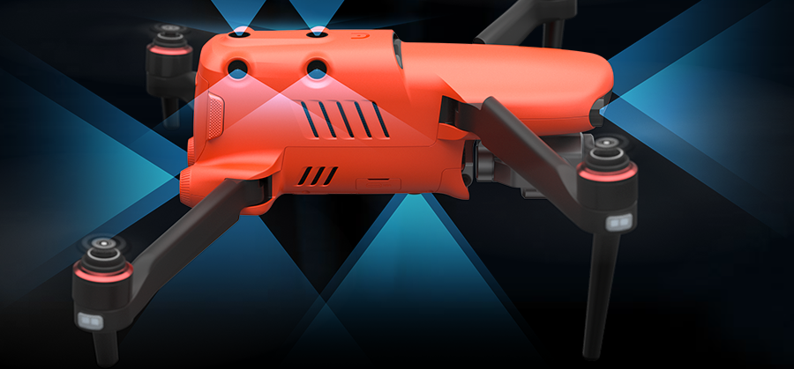
Autel Evo II Pro
UAS SURVEY PROOF OF CONCEPT
Aircraft
Amazing imaging capabilities in a lightweight, foldable form
Designed specifically for aerial photography
Equipped with autonomous positioning GPS
Ability to fly in winds up to 40mph
Battery life - maximum flight time 40 minutes
Onboard storage 256GB microSD card
Sensing System
Omnidirectional (360°)
Twelve visual sensors
Two Ultrasonic sensors
Dual IMU’s
Extremely stable aircraft with the ability to detect hazards up to 100 feet away, build 3D maps and plan flight paths through complex terrain in real time.

Slide 30
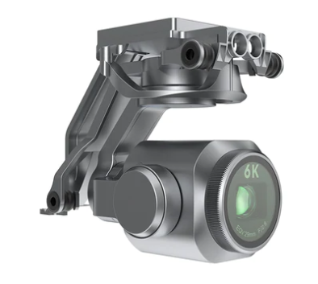
Autel Evo II Pro
UAS SURVEY PROOF OF CONCEPT
Camera
Sony 1” CMOS sensor
28.6mm lens
1-16X zoom
20MP’s
adjustable aperture range of f/2.8 - f/11
Enabling the pilot to produce images of exceptional precision and sharpness even in low-light conditions.
Gimble
Three-axis stabilization
Tilt range +30° to -90°
Pan range +90° to -90°

Slide 31
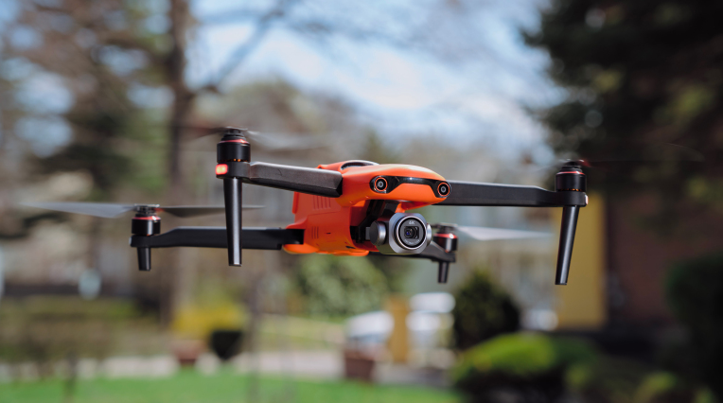
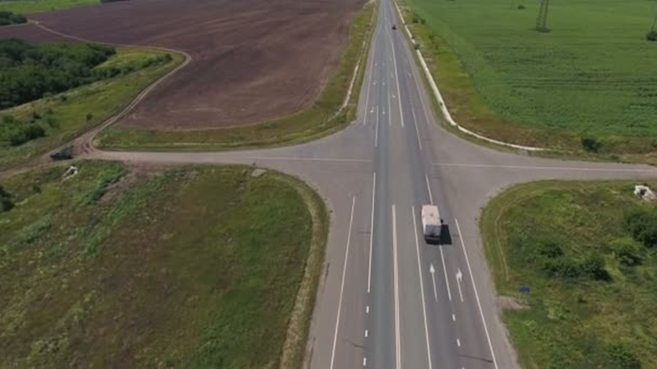
GOALS FOR UAS
Safety
Deploying this technology in high volume traffic, hazardous or inaccessible areas while keeping our employees at a safe distance is paramount.
Time Savings
Use UAS’s to quickly collect data, greatly reduce field time and produce a variety of surveying and mapping results to provide a basis for highway corridor development, environmental mitigation and hydrology studies.
Accuracy and Precision
Accuracy refers to how close a measurement is to its true value.
Precision refers to how close repeating measurements are to each other.
Using GPS post processing and ground control transformation we are hoping to achieve RTK accuracies and precisions of ±2cm (0.06’).

Slide 32
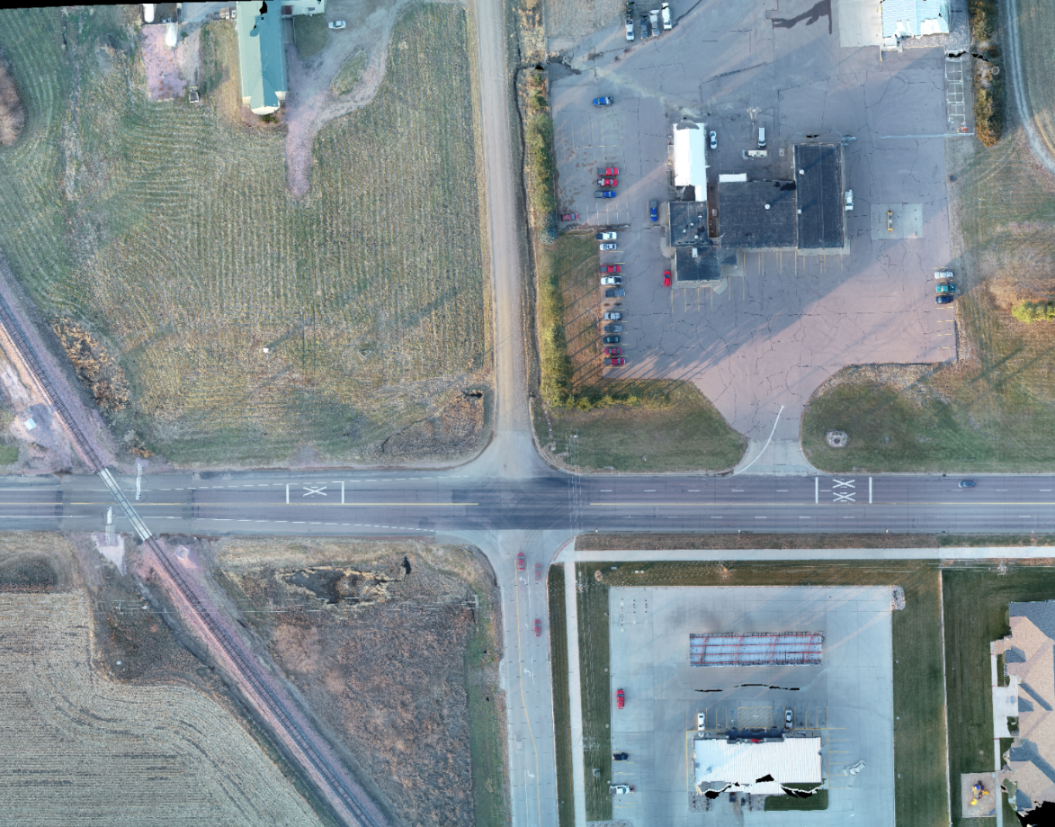
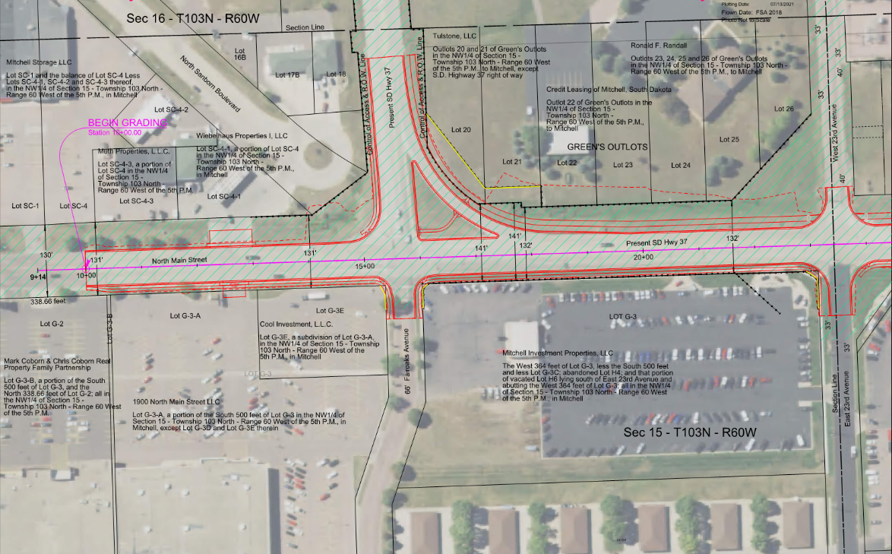
How are we using them…
Cartography
Collecting survey grade data on hard surfaces and areas with limited to no vegetation.
Aerial Imagery
Collecting aerial photography for use as background imagery for plans.
Stockpiles
Increased speed and accuracy of stockpile volume calculations.

Slide 33
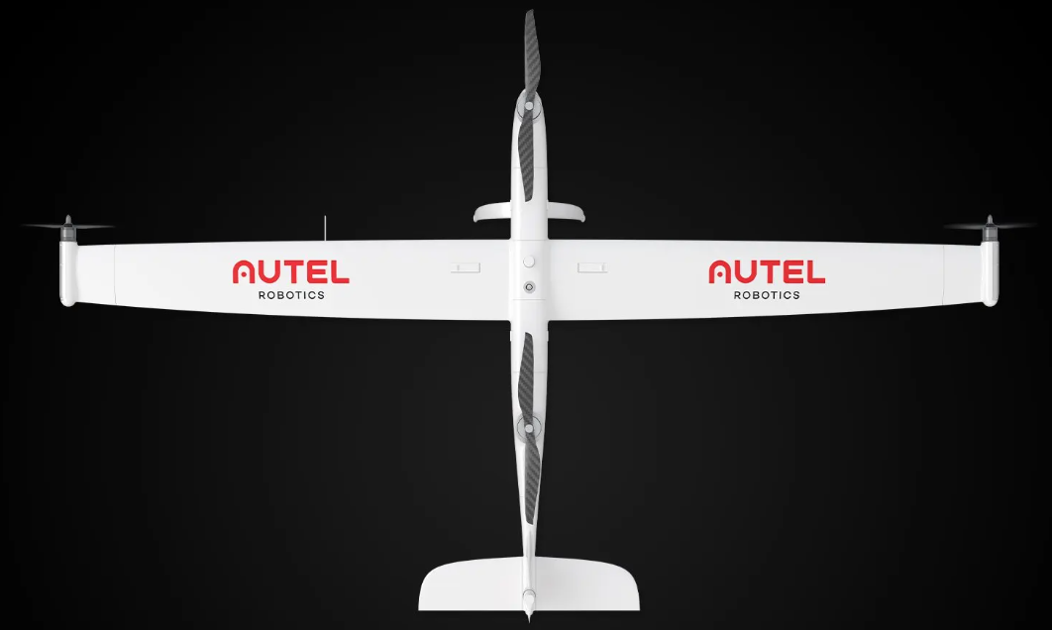
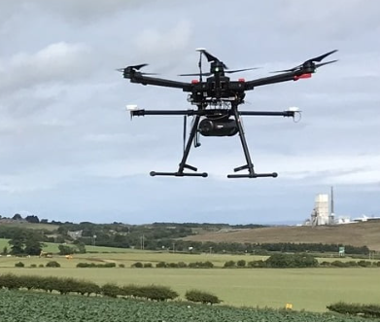
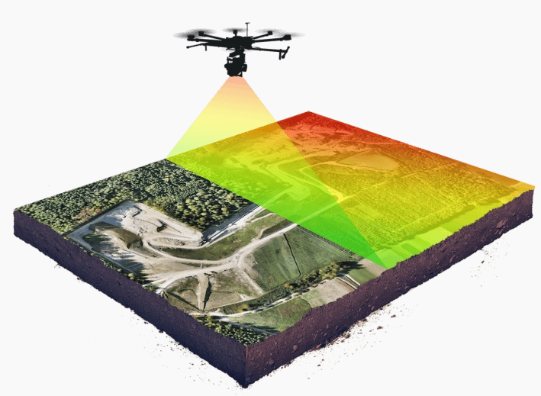
Where are we going?
UAS SURVEYS
Notes:
Ground surveys

Slide 34
SOUTH DAKOTA UAS WORKSHOP
Slide Body Content
LAANC
FAA’s Low Altitude Authorization and Notification Capability
Pilots can obtain airspace authorizations to fly in controlled airspace.
Mobile Applications:
B4UFLY
Aloft
AirMap
SDDOT has a blanket insurance policy for the UAS’s that is associated with the manned aircraft policy.
Each pilot and aircraft is insured.

Slide 35
CONTACT INFORMATION
Mailing Address
700 E Broadway Avenue
Email Address
larry.dean@state.sd.us
jon.nelson@state.sd.us
joshc.olson@state.sd.us

Slide 36
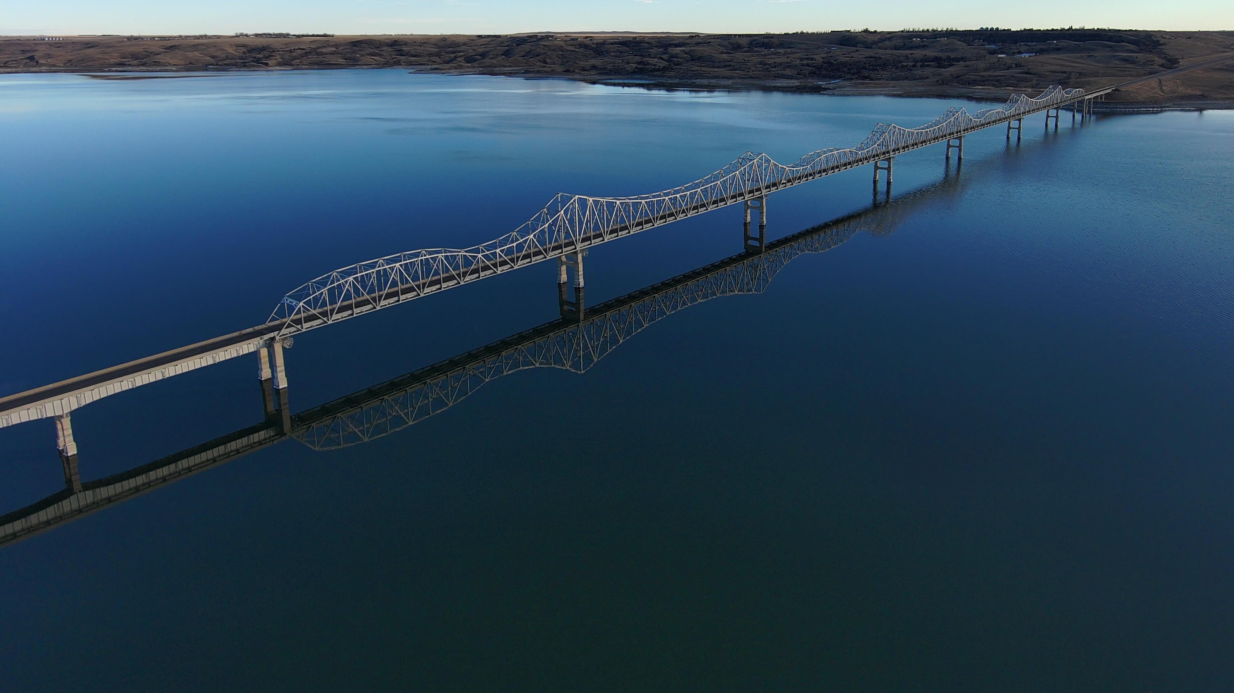
Questions?

